Slide 1
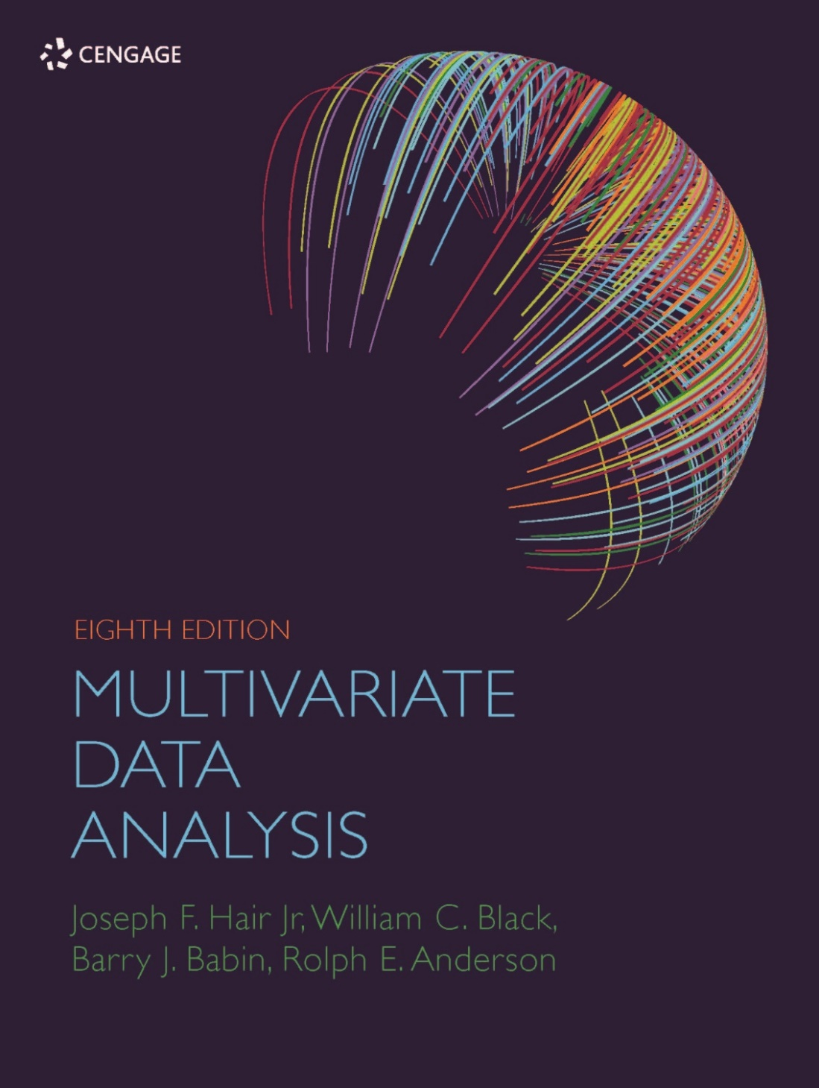
Chapter 1: Overview of Multivariate Methods

Slide 2
Learning Objectives
Upon completing this chapter, you should be able to do the following:
Explain what multivariate analysis is and when its application is appropriate.
Define and discuss the specific techniques included in multivariate analysis.
Determine which multivariate technique is appropriate for a specific research problem.
Discuss the nature of measurement scales and their relationship to multivariate techniques.
Describe the conceptual and statistical issues inherent in multivariate analyses.

Slide 3
Overview
What Is Multivariate Analysis?
Three Converging Trends
Multivariate Analysis in Statistical Terms
Some Basic Concepts of Multivariate Analysis
Managing the Multivariate Model
A Classification of Multivariate Techniques
Types of Multivariate Techniques
Guidelines for Multivariate Analyses and Interpretation
A Structured Approach to Multivariate Model Building
Databases
Organization of the Remaining Chapters

Slide 4
What Is Multivariate Analysis?

Slide 5
What is Multivariate Analysis?
What is multivariate?
Univariate, bivariate, and multivariate data
Multiple measurements on each individual or object under investigation.
What is multivariate analysis?
All statistical methods that simultaneously analyze multivariate measurements.
Why use it?
Methodological Benefits
Measurement
Explanation & Prediction
Hypothesis Testing
Improved decision making

Slide 6
Three Converging Trends
Topic 1: Rise of Big Data
Topic 2: Statistical Versus Data Mining Models
Topic 3: Causal Inference

Slide 7
Topic 1: The Rise of Big Data
Unique elements of Big Data focused in 6V areas:
Volume
Variety
Velocity
Veracity
Variability
Value
Impacts on:
Organizational Decisions and Academic Research – improved decision-making capabilities as well as the explosion of data available to characterize situations on dimensions never before available
Analytics and the Analyst – expansion of the domains of study embracing analytics as well as methodological challenges due to seemingly “unlimited” data
Problems – emerging on technological, ethical and sociological fronts

Slide 8
Topic 2: Statistical Versus Data Mining Models
Two fundamentally different approaches to data analysis (Breiman 2001):
Statistical/data models – analysis where a specific model is proposed (e.g., dependent and independent variables to be analyzed by the general linear model), the model is then estimated and a statistical inference is made as to its generalizability to the population through statistical tests.
Data mining/algorithmic models – models based on algorithms (e.g., neural networks, decision trees, support vector machine) that are widely used in many Big Data applications. Their emphasis is on predictive accuracy rather than statistical inference and explanation.
These two models truly represent different “cultures” of model building, coming from different research disciplines, operating on fundamentally different assumptions about how the models should operate and what are the most important objectives.

Slide 9
Comparing Between Statistical/Data Models and Data Mining/Algorithmic Models
No “best” approach, each has strengths and weaknesses.
Analysts today must assess each research situation and identify the best modeling approach for that specific situation (i.e., objective, data, etc.).

Slide 10
Topic 3: Causal Inference
Attempts to move beyond statistical inference to the stronger statement of “cause and effect” in non-experimental situations.
While causal statements have been primarily conceived as the domain of randomized controlled experiments, recent developments have provided researchers with . . .
the theoretical frameworks for understanding the requirements for causal inferences in non-experimental settings.
some techniques applicable to data not gathered in an experimental setting that still allow some causal inferences to be drawn.
Chapter 6 introduces confounds and other “threats” to causal inference and a popular methods for causal inference—propensity score models.

Slide 11
Multivariate Analysis in Statistical Terms

Slide 12
Defining Multivariate Analysis
All statistical techniques that simultaneously analyze multiple measurements on individuals or objects under investigation. Thus, any simultaneous analysis of more than two variables can be loosely considered multivariate analysis.
Many multivariate techniques are extensions of univariate procedures
Simple regression → Multiple regression
ANOVA → MANOVA
Many other techniques are uniquely multivariate
Factor analysis, cluster analysis, discriminant analysis

Slide 13
Some Basic Concepts of Multivariate Analysis
The Variate
Measurement Scales
Measurement Error and Multivariate Measurement

Slide 14
The Variate
The variate is a linear combination of variables with empirically determined weights.
Weights are determined to best achieve the objective of the specific multivariate technique.
Each respondent has a variate value (Y’).
The Y’ value is a linear combination of the entire set of variables. It is the dependent variable.
Variate equation: (Y’) = W₁ X₁ + W₂ X₂ + . . . + W_{n} X_{n}
W_{n} = empirically determined weights
X_{n} = independent variables
Potential Independent Variables:
X₁ = income
X₂ = education
X₃ = family size
X₄ = ??

Slide 15
Types of Data and Measurement Scales
Data
Nonmetric or Qualitative
Metric or Quantitative
Nominal Scale
Ordinal scale
Interval Scale
Ratio Scale

Slide 16
Measurement Scales
Nonmetric
Nominal – size of number is not related to the amount of the characteristic being measured.
Ordinal – larger numbers indicate more (or less) of the characteristic measured, but not how much more (or less).
Metric
Interval – contains ordinal properties, and in addition, there are equal differences between scale points.
Ratio – contains interval scale properties, and in addition, there is a natural zero point.
NOTE: The level of measurement is critical in determining the appropriate multivariate technique to use!

Slide 17
Measurement Error
All variables have some error. What are the sources of error?
Measurement error
distorts observed relationships and makes multivariate techniques less powerful.
Researchers use summated scales, for which several variables are summed or averaged together to form a composite representation of a concept.

Slide 18
Assessing Measurement Error
In addressing measurement error, researchers evaluate two important characteristics of measurement:
Validity
the degree to which a measure accurately represents what it is supposed to.
Reliability
the degree to which the observed variable measures the “true” value and is thus error free.

Slide 19
Managing the Multivariate Model
Managing the Variate
Managing the Dependence Model
Statistical Significance Versus Statistical Power

Slide 20
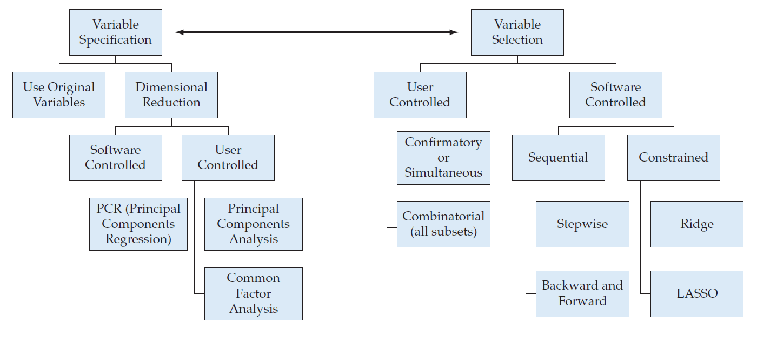
Managing the Variate
Preference is always for user control, but a large number of variables may necessitate software control.

Slide 21
Variable Specification and Variable Selection
Variable Specification – preparing the variables for analysis
Use original variables – retain most detailed attributes, but may suffer due to multicollinearity.
Dimensional reduction – develop some form of composites of original variables
User controlled – Exploratory factor analysis (principal components or common factor analysis).
Software controlled – Principal components regression (PCR).
Variable Selection – identifying the variables included in the analysis
User controlled – researcher explicitly defines variables in analysis.
Confirmatory or combinatorial
Software controlled.
Sequential – subset of variables included based on algorithm (e.g., stepwise)
Constrained – regression weight constrained to force some to zero or very low, effectively eliminating those variables from the analysis (e.g., ridge or LASSO)

Slide 22
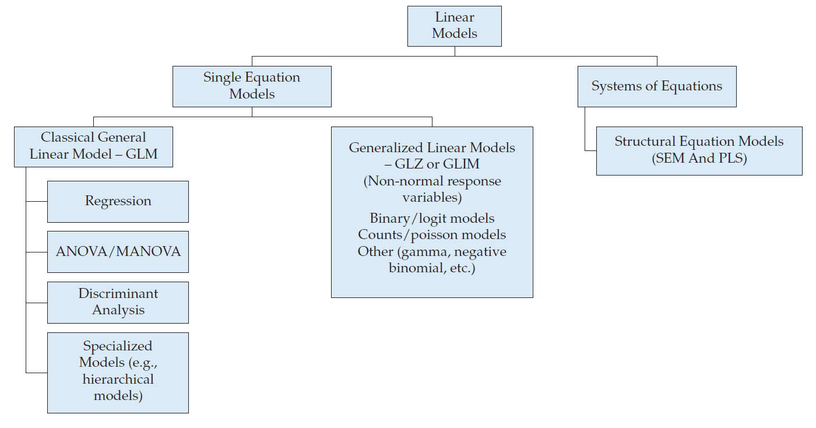
Managing the Dependence Model
Single Equation versus Multiple Equation Models
Single equation – most widely used methods in the past
Multiple equation – represents interrelated relationships
GLM versus GLZ/GLIM
GLM – classical OLS-based system of techniques
GLZ/GLIM – developed for non-normal response variables

Slide 23
Statistical Significance and Power
Type I error (α) – probability of rejecting the null hypothesis when it is true.
Type II error (β) – probability of failing to reject the null hypothesis when it is false.
Power (1 – β) – probability of rejecting the null hypothesis when it is false.

Slide 24
Power is Determined by Three Factors
Effect size:
the actual magnitude of the effect of interest (e.g., the difference between means or the correlation between variables).
Alpha (α):
as α is set at smaller levels, power decreases. Typically, α = .05.
Sample size:
as sample size increases, power increases. With very large sample sizes (1,000+), even very small effects can be statistically significant, raising the issue of practical significance vs. statistical significance.
#The overall effect sizes f ²≥ .02, .15, or .35 are regarded as small, moderate, and large effects, respectively.

Slide 25
Power Levels for the Comparison of Two Means: Variations by Sample Size, Significance Level, and Effect Size
Source: SOLO Power Analysis, BMDP Statistical Software, Inc.

Slide 26
Impact of Sample Size on Power

Slide 27
Rules of Thumb: Statistical Power Analysis
Researchers should always design the study to achieve a power level of .80 at the desired significance level.
More stringent significance levels (e.g., .01 instead of .05) require larger samples to achieve the desired power level.
Conversely, power can be increased by choosing a less stringent alpha level (e.g., .10 instead of .05).
Smaller effect sizes always require larger sample sizes to achieve the desired power.
Any increase in power is most likely achieved by increased sample size.

Slide 28
A Classification of Multivariate Techniques
Dependence Techniques
Interdependence Techniques

Slide 29
Dependence Techniques
Dependence techniques: a variable or set of variables is identified as the dependent variable to be predicted or explained by other variables known as independent variables.
Multiple Regression
Multiple Discriminant Analysis
Logit/Logistic Regression
Multivariate Analysis of Variance (MANOVA) and Covariance
Conjoint Analysis
Canonical Correlation
Structural Equations Modeling (SEM)
Partial Least Squares (PLS) Modeling

Slide 30
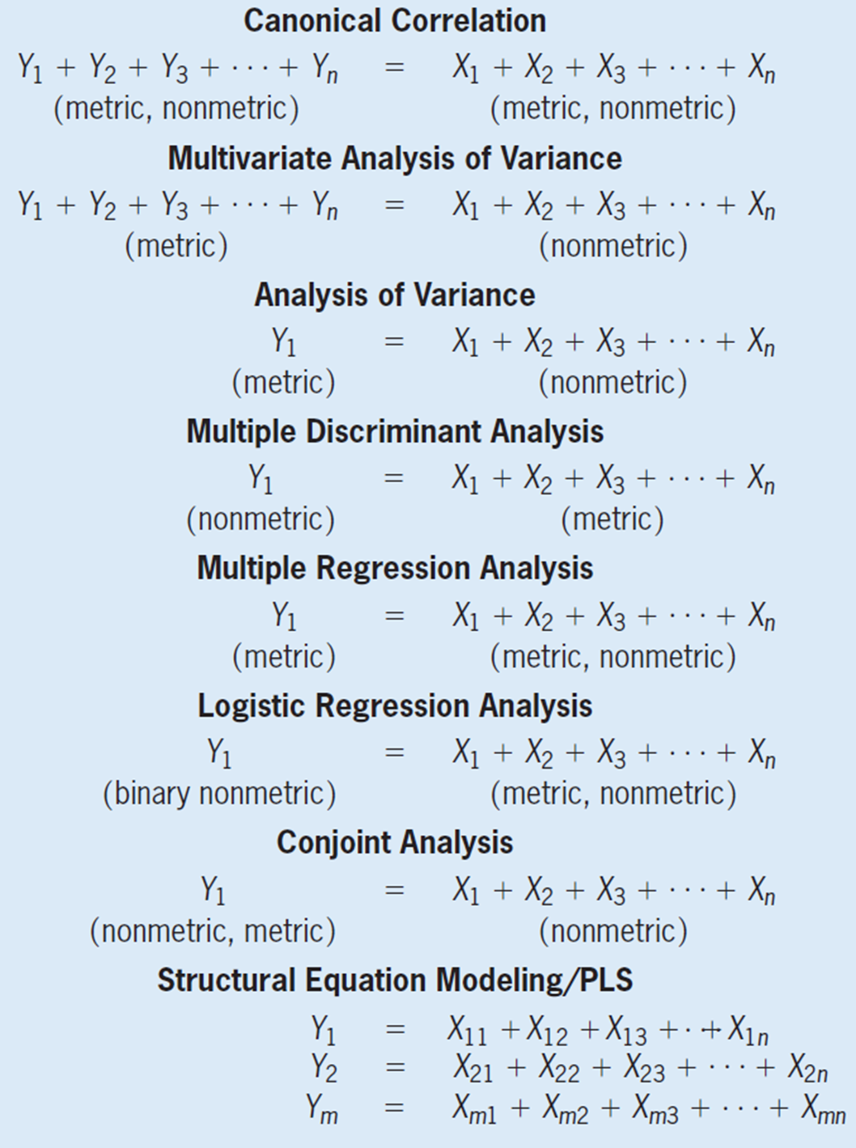
The Relationship Between Multivariate Dependence Methods

Slide 31
Interdependence Techniques
Interdependence techniques: involve the simultaneous analysis of all variables in the set, without distinction between dependent variables and independent variables.
Principal Components and Common Factor Analysis
Cluster Analysis
Multidimensional Scaling (perceptual mapping)
Correspondence Analysis

Slide 32
Selecting a Multivariate Technique
What type of relationship is being examined – dependence or interdependence?
Dependence relationship:
How many variables are being predicted?
What is the measurement scale of the dependent variable?
What is the measurement scale of the predictor variable (s)?
Interdependence relationship:
Are you examining relationships between variables, respondents, or objects?

Slide 33
Selecting the Correct Multivariate Method
Multivariate
Methods
Dependence
Methods
Interdependence
Methods
Multiple
Relationships -
Structural
Equations
One
Dependent
Variable
Several
Dependent
Variables
Metric
Nonmetric
CB-SEM
PLS
Metric
Nonmetric
Metric
Nonmetric
Factor
Analysis
Cluster
Analysis
Metric
MDS
Nonmetric
MDS and
Correspondence
Analysis
Multiple
Regression
and Conjoint
Discriminant
Analysis
and Logit
MANOVA
and
Canonical
Canonical
Correlation,
Dummy
Variables

Slide 34
Types of Multivariate Techniques

Slide 35
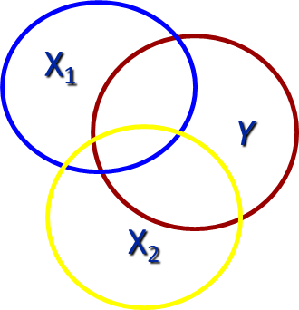
Dependence Techniques
Multiple Regression
What is it?
. . . a single metric dependent variable is predicted by several metric independent variables.
MANOVA
What is it?
. . . several metric dependent variables are predicted by a set of nonmetric (categorical) independent variables.

Slide 36
Dependence Techniques
Discriminant Analysis
What is it?
. . . single, non-metric (categorical)
dependent variable is predicted by
several metric independent variables.
Why use it?
Logistic Regression
What is it?
. . . single nonmetric dependent variable is predicted by several metric independent variables.
This technique is similar to discriminant analysis, but relies on calculations more like regression.
Examples of Dependent Variables:
Gender – Male vs. Female
Culture – USA vs. Outside USA
Purchasers vs. Non-purchasers
Member vs. Non-Member
Good, Average and Poor Credit Risk

Slide 37
Dependence Techniques
Canonical Analysis
What is it?
. . . several metric dependent variables are predicted by several metric independent variables.
Conjoint Analysis
What is it?
. . . quasi-experimental design based on attributes and levels of attributes which develops combinations of attributes/levels which are then evaluated by respondents.

Slide 38
Dependence Techniques
Structural Equation Modeling (SEM)
What is it?
. . . estimates multiple, interrelated dependence relationships based on two components:
Measurement Model
Structural Model
Two basic methodologies
CB-SEM – covariance-based SEM
PLS-SEM – Partial Least Squares Modeling
(variance-based)

Slide 39
Interdependence Techniques
Exploratory Factor Analysis (EFA)
What is it?
. . . analyzes the structure of the
interrelationships among a
large number of variables to
determine a set of
common underlying dimensions (factors).
Cluster Analysis
What is it?
. . . groups objects (respondents, products, firms, variables, etc.)
so that each object is similar to the other objects in the cluster and
different from objects in all the other clusters.

Slide 40
Interdependence Techniques
Multidimensional Scaling (MDS)
What is it?
. . . identifies “unrecognized” dimensions that affect purchase behavior based on customer judgments of
similarities or preferences
and transforms these into distances
represented as perceptual maps.
Correspondence Analysis
What is it?
. . . uses non-metric data and evaluates either linear or non-linear relationships in an effort to develop a perceptual map representing the association between objects (firms, products, etc.) and a set of descriptive characteristics of the objects.

Slide 41
Guidelines for Multivariate Analyses and Interpretation
Establish Practical Significance as well as Statistical Significance.
Sample Size Affects All Results.
Know Your Data.
Strive for Model Parsimony.
Look at Your Errors.
Simplify Your Models By Separation
Validate Your Results.

Slide 42
Guidelines for Multivariate Analysis
Establish Practical Significance as well as Statistical Significance.
Practical significance asks the question, “So what?”
Applicable to both managerial and academic contexts.
Sample Size Affects All Results.
Small samples – too little statistical power or too easily “overfitting” the data.
Large Samples – make the statistical tests overly sensitive.
Know Your Data.
Multivariate analyses require an even more rigorous examination of the data because the influence of outliers, violations of assumptions, and missing data can be compounded across several variables to create substantial effects.

Slide 43
Guidelines for Multivariate Analysis
Strive for Model Parsimony.
Irrelevant variables usually increase a technique’s ability to fit the sample data, but at the expense of overfitting the sample data and making the results less generalizable to the population.
Even though irrelevant variables typically do not bias the estimates of the relevant variables, they can mask the true effects due to an increase in multicollinearity.
Look at Your Errors.
starting point for diagnosing the validity of the obtained results.
indication of the remaining unexplained relationships.
Simplify Your Models By Separation
Estimate separate models when possible (e.g., in presence of moderators).
Validate Your Results.
Use split-sample or cross-validation to assess generalizability of any model.

Slide 44
A Structured Approach to Multivariate Model Building
Stage 1: Define the Research Problem, Objectives, and Multivariate Technique(s)
to be Used
Stage 2: Develop the Analysis Plan
Stage 3: Evaluate the Assumptions Underlying the Multivariate Technique(s)
Stage 4: Estimate the Multivariate Model and Assess Overall Model Fit
Stage 5: Interpret the Variate(s)
Stage 6: Validate the Multivariate Model
For use with Hair, Black, Babin and Anderson, Multivariate Data Analysis 8e © 2018 Cengage Learning EMEA

Slide 45
Databases
For use with Hair, Black, Babin and Anderson, Multivariate Data Analysis 8e © 2018 Cengage Learning EMEA

Slide 46
Description of HBAT Primary Database Variables
Variable Description | Variable Type
Data Warehouse Classification Variables
X₁ Customer Type X₂ Industry Type X₃ Firm Size X₄ Region X₅ Distribution System | Nonmetric Nonmetric Nonmetric Nonmetric Nonmetric
Performance Perceptions Variables
X₆ Product Quality X₇ E-Commerce Activities/Website X₈ Technical Support X₉ Complaint Resolution X₁₀ Advertising X₁₁ Product Line X₁₂ Salesforce Image X₁₃ Competitive Pricing X₁₄ Warranty & Claims X₁₅ New Products X₁₆ Ordering & Billing X₁₇ Price Flexibility X₁₈ Delivery Speed | Metric Metric Metric Metric Metric Metric Metric Metric Metric Metric Metric Metric Metric
Outcome/Relationship Measures
X₁₉ Satisfaction X₂₀ Likelihood of Recommendation X₂₁ Likelihood of Future Purchase X₂₂ Current Purchase/Usage Level X₂₃ Consider Strategic Alliance/Partnership in Future | Metric Metric Metric Metric Nonmetric
For use with Hair, Black, Babin and Anderson, Multivariate Data Analysis 8e © 2018 Cengage Learning EMEA

Slide 47
Other Databases
HBAT200
expanded version of the HBAT database containing 200 respondents used in Chapter 6 (MANOVA).
HBATMISS
Smaller database (70 observations) used to illustrate the handling of missing data.
HBAT_SEM
Larger database (400 observations) used in SEM chapters.
For use with Hair, Black, Babin and Anderson, Multivariate Data Analysis 8e © 2018 Cengage Learning EMEA

Slide 48
Organization of the Remaining Chapters
For use with Hair, Black, Babin and Anderson, Multivariate Data Analysis 8e © 2018 Cengage Learning EMEA

Slide 49
Section I: Preparing for a Multivariate Analysis
Chapter 2: Examining Your Data
Section II: Interdependence Techniques
Chapter 3: Exploratory Factor Analysis
Chapter 4: Cluster Analysis
Section III Dependence Techniques – Metric Outcomes
Chapter 5: Multiple Regression Analysis
Chapter 6: MANOVA: Extending ANOVA
Section IV Dependence Techniques – Non-metric Outcomes
Chapter 7: Multiple Discriminant Analysis
Chapter 8: Logistic Regression: Regression with a Binary Dependent Variable
Section V Moving Beyond The Basics
Chapter 9: Structural Equation Modeling: An Introduction
Chapter 10: SEM: Confirmatory Factor Analysis
Chapter 11: Testing Structural Equation Models
Chapter 12: Advanced SEM Topics
Chapter 13: Partial Least Squares Structural Equation Modeling (PLS-SEM)
For use with Hair, Black, Babin and Anderson, Multivariate Data Analysis 8e © 2018 Cengage Learning EMEA

Slide 50
Multivariate Analysis Learning Checkpoint
What is multivariate analysis?
Why use multivariate analysis?
Why is knowledge of measurement scales important in using multivariate analysis?
What basic issues need to be examined when using multivariate analysis?
Describe the process for applying multivariate analysis.
For use with Hair, Black, Babin and Anderson, Multivariate Data Analysis 8e © 2018 Cengage Learning EMEA

