Slide 1
Chapter 6 MANOVA: Extending ANOVA
For use with Hair, Black, Babin and Anderson, Multivariate Data Analysis 8e © 2018 Cengage Learning EMEA

Slide 2
Learning Objectives
Upon completing this chapter, you should be able to do the following:
Explain the difference between the univariate null hypothesis of ANOVA and the multivariate null hypothesis of MANOVA.
Discuss the advantages of a multivariate approach to significance testing compared to the more traditional univariate approaches.
State the assumptions for the use of MANOVA.
Discuss the different types of test statistics that are available for significance testing
Describe the purpose of post hoc tests in ANOVA and MANOVA.
Interpret interaction results when more than one independent variable is used.
Describe the purpose of multivariate analysis of covariance (MANCOVA).
Describe the uses and insights gained from incorporating mediation and moderation effects.
Identify situations in which causal inferences may be strengthened even in non-randomized studies.
For use with Hair, Black, Babin and Anderson, Multivariate Data Analysis 8e © 2018 Cengage Learning EMEA

Slide 3
Overview
Re-Emergence of Experimentation
Experimental Approaches Versus Other Multivariate Methods
MANOVA: Extending Univariate Methods for Assessing Group Differences
A Decision Process for MANOVA
Stage 1: Objectives of MANOVA
Stage 2: Issues in the Research Design of MANOVA
Stage 3: Assumptions of ANOVA and MANOVA
Stage 4: Estimation of the MANOVA Model and Assessing Overall Fit
Stage 5: Interpretation of the MANOVA Results
Stage 6: Validation of the Results
Advanced Issues: Causal Inference in Nonrandomized Situations
Illustration of a MANOVA Analysis
For use with Hair, Black, Babin and Anderson, Multivariate Data Analysis 8e © 2018 Cengage Learning EMEA

Slide 4
Re-Emergence of Experimentation
For use with Hair, Black, Babin and Anderson, Multivariate Data Analysis 8e © 2018 Cengage Learning EMEA

Slide 5
Re-Emergence of Experimentation
Experimentation long been the foundational principle of the scientific method of research.
Yet while social sciences have been less frequent users of experimentation in the past, that trend is being reversed.
Traditional randomized laboratory experiments becoming increasingly common in consumer behavior and behavioral economics.
Field experiments have become increasingly common both in academic setting and the business sector.
For use with Hair, Black, Babin and Anderson, Multivariate Data Analysis 8e © 2018 Cengage Learning EMEA

Slide 6
Experimental Approaches Versus Other Multivariate Methods
For use with Hair, Black, Babin and Anderson, Multivariate Data Analysis 8e © 2018 Cengage Learning EMEA

Slide 7
What Distinguishes The Experimental Approach?
Primary objective: Focus on a single or small number of “causes” to establish a very specific “effect.”
Basic elements of an experiment
Treatment → Outcome.
Treatment/factor – a conceptual “cause” of a specific outcome (i.e., cause → effect).
Experimental design – research approach based on developing a narrowly focused research program which can be tested in a hypothesis or set of hypotheses.
Distinguished from the techniques/methods typically used in analyzing this type of data (e.g., ANOVA and MANOVA) by its rigid research controls to isolate the proposed “cause” as the only factor which has a relationship with the outcome.
For use with Hair, Black, Babin and Anderson, Multivariate Data Analysis 8e © 2018 Cengage Learning EMEA

Slide 8
MANOVA: Extending Univariate Methods for Assessing Group Differences
For use with Hair, Black, Babin and Anderson, Multivariate Data Analysis 8e © 2018 Cengage Learning EMEA

Slide 9
MANOVA Defined
Multivariate extension of ANOVA for assessing the differences between group means on more than one dependent variable at the same time.
Basic elements
A variate is tested for equality.
Actually two variates are compared – one for the dependent variables and another for the independent variables.
The dependent variable variate is of more interest because the metric-dependent measures can be combined in a linear combination, as we have already seen in multiple regression and discriminant analysis.
The unique aspect of MANOVA is that the variate optimally combines the multiple dependent measures into a single value that maximizes the differences across groups.
Cells/groups
Formed by combinations of independent variables (factorial designs) (e.g., 2 x 2 = four cells).
For use with Hair, Black, Babin and Anderson, Multivariate Data Analysis 8e © 2018 Cengage Learning EMEA

Slide 10
ANOVA vs. MANOVA
The relationship between the univariate and multivariate procedures is shown below:
 | Number of Dependent Variables
Number of Groups in Independent Variable | One (Univariate) | Two or More (Multivariate)
Two Groups (Specialized Case) | t-test | Hotelling’s T²
Two or More Groups (Generalized Case) | Analysis of Variance (ANOVA) | Multivariate Analysis of Variance (MANOVA)
For use with Hair, Black, Babin and Anderson, Multivariate Data Analysis 8e © 2018 Cengage Learning EMEA

Slide 11
Differences Between MANOVA and Discriminant Analysis
To some extent, they are “mirror images” of each other:
The dependent variables in MANOVA (a set of metric variables) are the independent variables in discriminant analysis.
The single nonmetric dependent variable of discriminant analysis becomes the independent variable in MANOVA.
Both use the same methods in forming the variates and assessing the statistical significance between groups.
Differences are in the Research Objectives
In discriminant analysis, the groups formed by the nonmetric dependent measure are assumed as given and interest is in the set of metric independent variables for their ability to discriminate among the groups.
In MANOVA, the set of metric variables used as dependent measures are assumed given and interest is in finding the nonmetric variable(s) that form groups with the greatest differences on the set of dependent measures.
For use with Hair, Black, Babin and Anderson, Multivariate Data Analysis 8e © 2018 Cengage Learning EMEA

Slide 12
Decision Process For MANOVA
Stage 1: Objectives of MANOVA
Stage 2: Issues in the Research Design of MANOVA
Stage 3: Assumptions of ANOVA and MANOVA
Stage 4: Estimation of the MANOVA Model and Assessing
Overall Fit
Stage 5: Interpretation of the MANOVA Results
Stage 6: Validation of the Results
For use with Hair, Black, Babin and Anderson, Multivariate Data Analysis 8e © 2018 Cengage Learning EMEA

Slide 13
Stage 1: Objectives of MANOVA
When Should We Use MANOVA?
Types of Multivariate Questions Suitable for MANOVA
Selecting the Dependent Measures
For use with Hair, Black, Babin and Anderson, Multivariate Data Analysis 8e © 2018 Cengage Learning EMEA

Slide 14
When Should We Use MANOVA
Objectives
Analyze a dependence relationship represented as the differences in a set of dependent measure across groups formed by one or more nonmetric independent measures.
To provide insights into the nature and predictive power of the independent measures as well as the interrelationships and differences in the multiple dependent measures.
Benefits
Controlling the experiment-wide error rate when there is some degree of intercorrelation among dependent variables.
More statistical power than ANOVA when 5 or less dependent variables.
May detect combined effects among dimensions (i.e., variates) of the dependent measures.
For use with Hair, Black, Babin and Anderson, Multivariate Data Analysis 8e © 2018 Cengage Learning EMEA

Slide 15
Types of Multivariate Questions Suitable for MANOVA
Multiple Univariate Questions
Control for overall experiment-wide error rate with overall test followed up by univariate tests.
Structured Multivariate Questions
Specific relationships between dependent measures requires joint testing.
Intrinsically Multivariate Questions
Principal concern is how the whole set of independent variables differ across groups, with combined effect more of interest than separate effects.
For use with Hair, Black, Babin and Anderson, Multivariate Data Analysis 8e © 2018 Cengage Learning EMEA

Slide 16
Selecting the Dependent Measures
Researchers should include only dependent variables that have strong theoretical support
Inappropriate or irrelevant variables can not be empirically removed (e.g., no sequential inclusion method) and thus can impact the overall tests.
Levels of correlation among dependent measures
If inter-correlations are very high (> .7 or .8), they have a tendency to create redundancies and reduce the statistical efficiency. This may become especially impactful if multiple composite variates (i.e., discriminant functions) are formed when analyzing two or more independent variables.
If correlations are very low (< .3), the analyst should consider running separate ANOVAs and adjusting for the experiment-wide error (e.g., Bonferroni adjustment).
For use with Hair, Black, Babin and Anderson, Multivariate Data Analysis 8e © 2018 Cengage Learning EMEA

Slide 17
Stage 2: Issues in the Research Design of Manova
Types of Research Approaches
Types of Variables in Experimental Research
Sample Size Requirements—Overall and by Group
Factorial Designs—Two or More Treatments
Using Covariates—ANCOVA and MANCOVA
Modeling Other Relationships Between Treatment and Outcome
MANOVA Counterparts of Other ANOVA Designs
A Special Case of MANOVA: Repeated Measures
For use with Hair, Black, Babin and Anderson, Multivariate Data Analysis 8e © 2018 Cengage Learning EMEA

Slide 18
MANOVA is Applicable to Multiple Research Approaches
Experimentation: Randomization of Groups
Controlled experiment – respondents are randomly assigned to treatment or control group to ensure that causal inferences can be made.
Field experiment – implementation of a controlled experiment in a “natural” setting (i.e., outside a controlled laboratory environment) in an attempt to increase external validity, but also raising threats to internal validity.
Experimentation: Non-Randomization
Quasi-experiment – similar to a controlled experiment except it lacks assignment to the two groups through randomization.
Natural experiment – non-random form of experimental research where the treatment occurs naturally (e.g., natural disaster, etc.).
Non-experimental
Observational study (cross-sectional study) – non-random research design limited since respondent selection is not controlled by the researcher and confounds are very difficult to identify and then account for in the analysis.
For use with Hair, Black, Babin and Anderson, Multivariate Data Analysis 8e © 2018 Cengage Learning EMEA

Slide 19
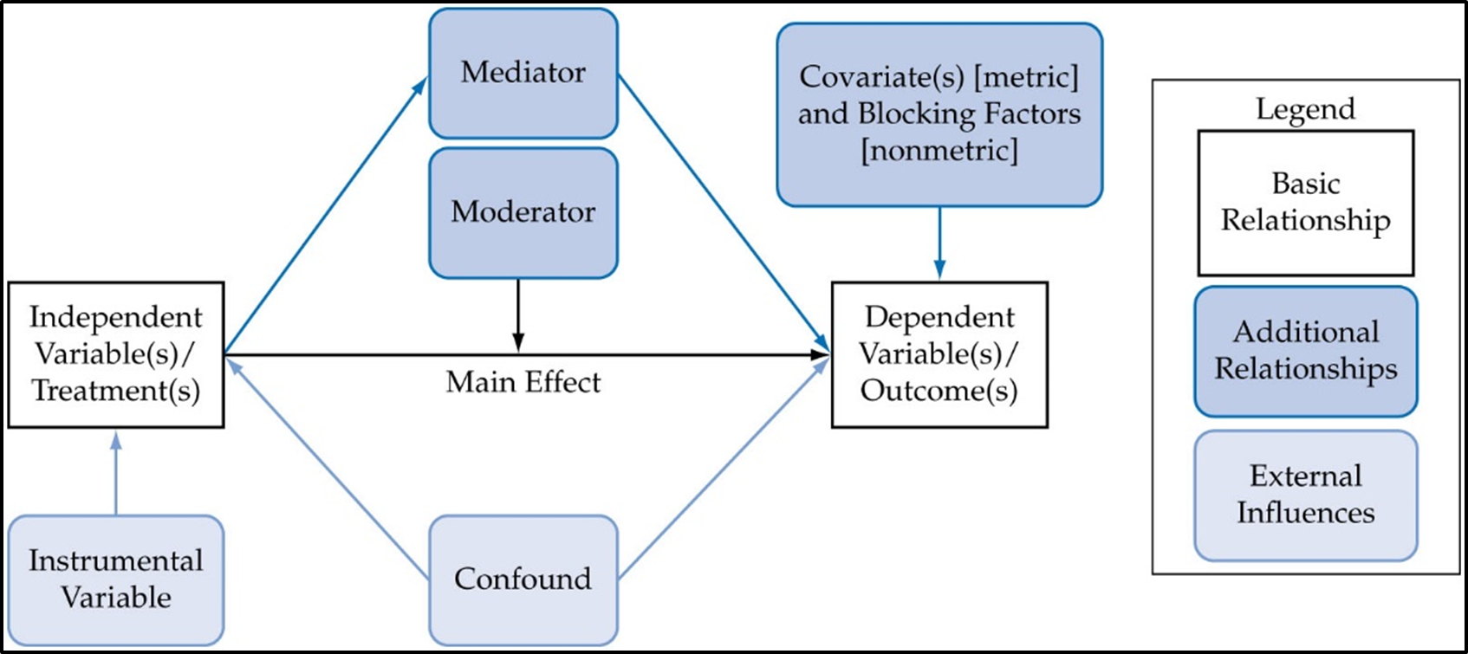
Types of Variables in Experimental Research
Basic Relationship: primary interest of the research
Treatment/factor – independent variable which is hypothesized as the reason/”cause” of the outcome variable.
Outcome – dependent variable which represents the values arising from the different levels of the treatments/factors.
Main effect – individual effect of a treatment variable on the dependent variable(s).
For use with Hair, Black, Babin and Anderson, Multivariate Data Analysis 8e © 2018 Cengage Learning EMEA

Slide 20
Types of Variables in Experimental Research
Additional Relationships
Mediator – An intervening variable that attempts to explain “Why” a treatment → outcome relationship occurs. The mediator is assumed to be “caused” by the treatment and the mediator then “causes” the outcome in a causal chain.
Moderator – The strength and/or direction of a main effect varies between different values of a third variable—the moderator.
Covariates – metric independent variables used to address extraneous/uncontrolled (nuisance) variation in the dependent variables.
Blocking factor – additional factor most often used as a control variable.
External Influences
Confound – omitted variable from the analysis which is related to both factor and outcome such that it acts as another “cause” for the main effect, creating bias
Instrumental variable – related solely to the treatment that is used in observational studies to “control” for confounds and allowing for making causal inferences.
For use with Hair, Black, Babin and Anderson, Multivariate Data Analysis 8e © 2018 Cengage Learning EMEA

Slide 21
Sample Size Requirements: Overall and By Group
Overall sample size not as important as sample size per group
Group/Cell Sample size
Minimum sample size per group must be greater than the number of dependent variables.
The recommended minimum cell size is 20 observations per cell (group).
Increasing number of dependent variables – increases minimum cell size needed for desired statistical power.
Balanced design – equal sample size per group is desired.
For use with Hair, Black, Babin and Anderson, Multivariate Data Analysis 8e © 2018 Cengage Learning EMEA

Slide 22
Factorial Designs—Two or More Treatments
Factorial design – number of groups formed with 2 or more treatments.
Selecting Treatments
Theoretical construct of interest, in most controlled experiments are manipulated.
Manipulation check – variable(s) assessing if respondents perceive manipulation correctly. Done solely to validate the manipulation, not impact on outcome.
Instructional manipulation check – check to assess if instructions being followed
Control variables – blocking factor (aka nuisance factor) is nonmetric characteristic to account for expected variability or control for confound to avoid bias in main effect estimation.
Number of treatments
Two or more treatments requires:
Concern over number of cells formed
Creation of interaction effects
For use with Hair, Black, Babin and Anderson, Multivariate Data Analysis 8e © 2018 Cengage Learning EMEA

Slide 23
Using Covariates—ANCOVA and MANCOVA
Similar to a blocking factor, covariates can achieve two specific objectives:
Eliminate some systematic error outside the researcher’s control can bias the results.
Account for differences due to unique characteristics of the respondents.
Selecting a Covariate
Should be highly correlated with the dependent variable(s) but not correlated with the treatment(s).
Number of Covariates – fewer the better
Maximum number of covariates = (.10 x Sample size) – (Number of groups – 1).
Assumptions for Covariates
Must have some relationship/correlation with the dependent measures.
Must have a homogeneity of regression effect (equal effect on dependent measures across groups).
For use with Hair, Black, Babin and Anderson, Multivariate Data Analysis 8e © 2018 Cengage Learning EMEA

Slide 24
Modeling Other Relationships Between Treatment and Outcome
Mediation
A third variable that “links” the treatment and outcome. Many times it is conceptualized as the variable that transmits the main effect to the outcome
Provides an explanation of “why” and “how” a main effect occurs.
In simple terms, the treatment causes the mediator, and in turn, the mediator causes the outcome.
Commonly known as an indirect or intervening effect.
Moderation
Strength and/or direction of a main effect varies between different values of the moderator.
Provides an explanation of “when” a main effect occurs.
Represented by an interaction effect.
Classic example: differences in main effect due to gender.
For use with Hair, Black, Babin and Anderson, Multivariate Data Analysis 8e © 2018 Cengage Learning EMEA

Slide 25
A Special Case of MANOVA: Repeated Measures
Issue
When same respondent provides several measures, such as test scores over time, and we wish to examine them to see whether any trend emerges.
Without special treatment, however, we would be violating the most important assumption, independence, since same individual provided multiple measures.
Repeated Measures models
Account for this dependence and still ascertain whether any differences occurred across individuals for the set of dependent variables.
MANOVA
Provides a means of analysis where each repeated measure is treated separately to mitigate violation of the sphericity assumption.
For use with Hair, Black, Babin and Anderson, Multivariate Data Analysis 8e © 2018 Cengage Learning EMEA

Slide 26
Stage 3: Assumptions of ANOVA and MANOVA
Independence
Equality of Variance–Covariance Matrices
Normality
Linearity and Multicollinearity among the Dependent Variables
Sensitivity to Outliers
For use with Hair, Black, Babin and Anderson, Multivariate Data Analysis 8e © 2018 Cengage Learning EMEA

Slide 27
Assumptions of MANOVA
Independence
Most common violations:
time-ordered effects (serial correlation)
gathering information in group settings (i.e., context effect resulting in nested or grouped data)
Equality of Variance–Covariance Matrices
Concerned with substantial differences in the amount of variance of one group versus another for the dependent variables (similar to the problem of heteroscedasticity in multiple regression and homogeneity of variance in ANOVA)
Empirical test: Box M test
Very conservative test, generally use strict alpha levels (.01 or less)
Remedies for violations
Check and correct for normality with variable transformations
Strive for equal cell sizes, if unequal, adjust alpha level used
For use with Hair, Black, Babin and Anderson, Multivariate Data Analysis 8e © 2018 Cengage Learning EMEA

Slide 28
Assumptions of MANOVA
Normality
Assumes a multivariate normal distribution where the joint effect of two variables is normally distributed.
Typically assured is achieve univariate normality.
Linearity and Multicollinearity among the Dependent Variables
Linearity is assumed among dependent measures.
Multicollinearity should not be too high to create redundant measures.
Sensitivity to Outliers
Results sensitive to outliers, especially as cell sample sizes decrease.
For use with Hair, Black, Babin and Anderson, Multivariate Data Analysis 8e © 2018 Cengage Learning EMEA

Slide 29
Stage 4: Estimation of the MANOVA Model and Assessing Overall Fit
Estimation with the General Linear Model
Measures for Significance Testing
Statistical Power of the Multivariate Tests
Estimating Additional Relationships: Mediation and Moderation
For use with Hair, Black, Babin and Anderson, Multivariate Data Analysis 8e © 2018 Cengage Learning EMEA

Slide 30
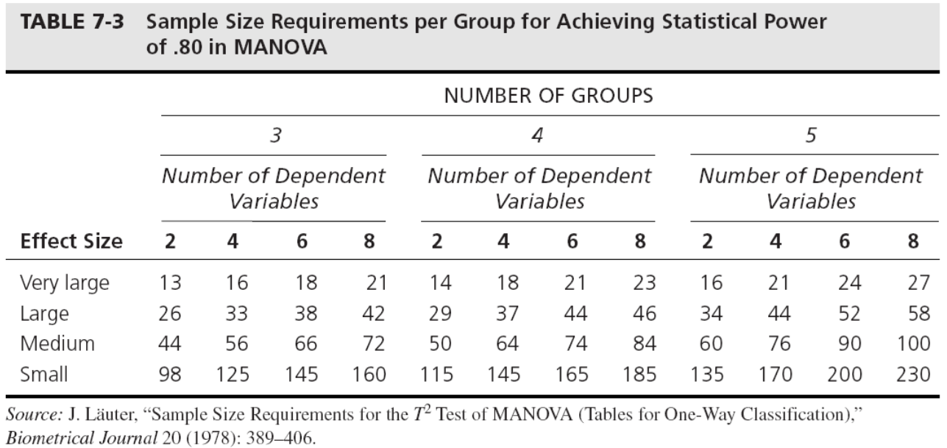
Sample Size Requirements—Overall and by Group
For use with Hair, Black, Babin and Anderson, Multivariate Data Analysis 8e © 2018 Cengage Learning EMEA

Slide 31
Estimation with the General Linear Model
General Linear Model
More general version of the basic linear model in that it can accommodate a wide range of dependence models.
Many times used instead of specific procedure for MANOVA.
Provides extension of ANOVA.
Differs from the generalized linear model (GLZ), which allows error distributions other than the normal distribution.
For use with Hair, Black, Babin and Anderson, Multivariate Data Analysis 8e © 2018 Cengage Learning EMEA

Slide 32
Measures for Significance Testing
Identical to those used for discriminant analysis
Widely used measures include:
Roy’s greatest characteristic root (gcr) – measures the differences on only the first discriminant function among the dependent variables.
Wilks’ lambda (also known as the U statistic) – many times referred to as the multivariate F and is commonly used for testing overall significance between groups in a multivariate situation.
Pillai’s criterion and Hotelling’s T² – consider all the characteristic roots and can be approximated by an F statistic.
Preferred measures
Pillai’s criterion or Wilks’ lambda – if all assumptions met and equal cell sizes.
Pillai’s criterion is considered more robust and used if assumptions violated.
Roy’s gcr – assumptions met and only 1 dimension among dependent variables.
For use with Hair, Black, Babin and Anderson, Multivariate Data Analysis 8e © 2018 Cengage Learning EMEA

Slide 33
Statistical Power of the Multivariate Tests
Statistical Power
probability that a statistical test will identify a treatment’s effect if it actually exists
Impacts on Statistical Power
Statistical Significance Level ALPHA (α) – power is inversely related to alpha
Increasing alpha (e.g., from .05 to .01) – more selective, reduces power
Decreasing alpha (e.g., from .05 to .10) – less selective, more likely to indicate differences
Effect size – directly related to effect size
Larger effect sizes have more power (i.e., are easier to find) than smaller effect sizes.
Magnitude of the effect size has a direct impact on the power of the statistical test
Sample size – increased sample size improves power
Cell sizes of under 30 have noticeable reduction in power
Once cell sizes reach 150, negligible improvements
Number of dependent measures
Increased number of dependent variables requires increased sample sizes to maintain power
For use with Hair, Black, Babin and Anderson, Multivariate Data Analysis 8e © 2018 Cengage Learning EMEA

Slide 34
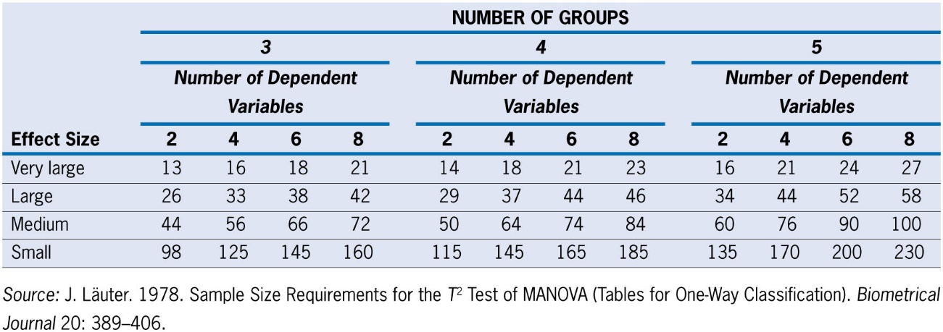
Calculating Power Levels
Sample Size Requirements per Group for Achieving Statistical Power of .80
Using Power in Planning and Analysis
Judgments of effect size and desired alpha can assist in sample size determination.
Effects of Dependent Variable Multicollinearity on Power
must consider the strength and direction of the correlations as well as the effect sizes of the dependent variables.
For use with Hair, Black, Babin and Anderson, Multivariate Data Analysis 8e © 2018 Cengage Learning EMEA

Slide 35
Estimating Additional Relationships: Mediation
Involves two additional relationships (A and B, see figure below) which create the indirect or intervening effect (A x B)
Introducing this indirect effect into the analysis allows for an “alternative” effect to supplant the direct effect (C).
The result is two types of mediation:
Complete mediation -- C’ becomes non significant
Partial mediation – C’ is still significant while the indirect effect is also significant
Statistical significance of the indirect effect tested by Sobel test or bootstrapping
For use with Hair, Black, Babin and Anderson, Multivariate Data Analysis 8e © 2018 Cengage Learning EMEA

Slide 36
Estimating Additional Relationships: Moderation
Represents the change in a relationship due to a one unit change in the moderator variable (more detailed discussion in Stage 5)
Estimation is a 3-step Process
Calculate the interaction term between treatment and moderator.
Estimate the moderated relationship, with three independent variables (treatment, moderator and interaction term of treatment x moderator).
Moderation is indicated by a statistically significant coefficient for the interaction term.
PROCESS Macro
Provides estimation in both SAS and SPSS for multiple forms of mediation and moderation.
For use with Hair, Black, Babin and Anderson, Multivariate Data Analysis 8e © 2018 Cengage Learning EMEA

Slide 37
Stage 5: Interpretation of the MANOVA Results
Evaluating Covariates
Assessing Effects on the Dependent Variate
Identifying Differences Between Individual Groups
Assessing Significance for Individual Outcome Variables
Interpreting Mediation and Moderation
For use with Hair, Black, Babin and Anderson, Multivariate Data Analysis 8e © 2018 Cengage Learning EMEA

Slide 38
Evaluating Covariates
Primary Impact:
Increase in statistical significance for main effects and interactions by reducing within-group variation.
Assessing Impact:
Estimate model with and without covariates and then determine is covariates have positive benefit to statistical significance testing.
Interpreting Covariates
If covariates represent theoretically based effects, then these results provide an objective basis for accepting or rejecting the proposed relationships.
In a practical vein, the researcher can examine the impact of the covariates and eliminate those with little or no effect.
For use with Hair, Black, Babin and Anderson, Multivariate Data Analysis 8e © 2018 Cengage Learning EMEA

Slide 39
Assessing Effects on the Dependent Variate: Main Effects
Main effect: difference between groups formed by independent variable(s)
Assessing significant effects
Multivariate measures – difference on variate of dependent variables.
Univariate measures – test each dependent variable separately.
Presence of Significant Main effects Requires:
If the analysis includes more than one treatment, the researcher must examine the interaction terms to see whether they are significant and, if so, whether they allow for an interpretation of the main effects.
If a treatment involves more than two levels, then the researcher must perform a series of additional tests between the groups to see which pairs of groups are significantly different.
For use with Hair, Black, Babin and Anderson, Multivariate Data Analysis 8e © 2018 Cengage Learning EMEA

Slide 40
Assessing Effects on the Dependent Variate: Interactions
Interaction: Joint effect of two or more treatments
Assessing significant effects
Multivariate measures – difference on variate of dependent variables.
Univariate measures – test each dependent variable separately.
Types of Significant Interactions
Ordinal
effects of a treatment are not equal across all levels of another treatment, but the group difference(s) is always the same direction.
Main effect has consistent interpretation, but must be assessed at each level of variable.
Disordinal
differences between levels switch, depending on how they are combined with levels from another treatment.
No consistent difference between groups (e.g., females not always greater than males).
May be significant without either main effect being significant.
For use with Hair, Black, Babin and Anderson, Multivariate Data Analysis 8e © 2018 Cengage Learning EMEA

Slide 41
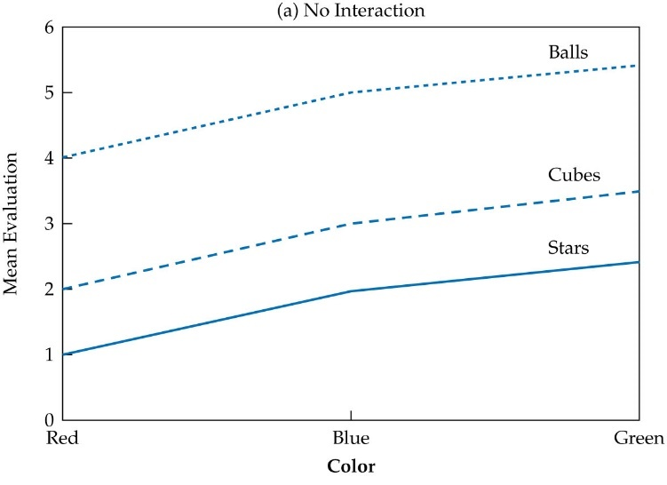
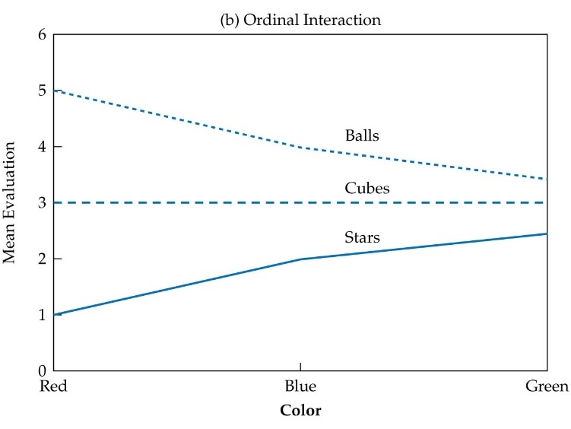
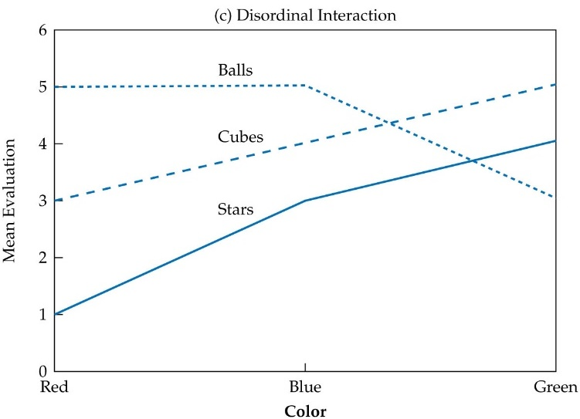
Graphical Portrayal of Interactions
For use with Hair, Black, Babin and Anderson, Multivariate Data Analysis 8e © 2018 Cengage Learning EMEA

Slide 42
Identifying Differences Between Individual Groups
When more than two groups for a treatment, significant main effects do not guarantee that all differences between groups are significant
Approaches for Identifying Individual Group differences
Multiple Univariate Tests Adjusting for the Experiment-wide Error Rate
Testing all possible group differences while adjusting alpha level with Bonferroni inequality.
Structured Multigroup Tests
Post Hoc Tests – Tests of the dependent variables between all possible pairs of group differences that are tested after the data patterns are established.
quite low levels of power for any individual test because they examine all possible combinations.
A Priori or Planned Comparisons – Tests planned from a theoretical or practical decision-making viewpoint prior to looking at the data. Best employed when:
The researcher can specify which group comparisons are to be made versus testing the entire set.
Planned comparisons are more powerful because of the smaller number of comparisons, but requires conceptual basis for specifying which group comparisons are made.
For use with Hair, Black, Babin and Anderson, Multivariate Data Analysis 8e © 2018 Cengage Learning EMEA

Slide 43
Assessing Significance for Individual Outcome Variables
Result of a multivariate test of differences across the set of outcomes does not necessarily extend to each variable separately, just collectively.
Thus, the researcher should always examine the multivariate results for the extent to which they extend to the individual outcome measures.
Approaches For Assessing Individual Outcome Variables
Univariate significance tests – separate univariate significance tests for each outcome.
Discriminant analysis
designate a treatment as the dependent variable in the discriminant analysis and the outcomes as the independent variables.
Multivariate significance tests will (a) test for the significance of the set of outcomes for that treatment and (b) identify which of the outcomes are predictive of the difference.
Stepdown analysis
Computing a univariate F statistic for a dependent variable after eliminating the effects of other dependent variables preceding it in the analysis.
Requires sequential ordering of dependent variables which can markedly impact results.
For use with Hair, Black, Babin and Anderson, Multivariate Data Analysis 8e © 2018 Cengage Learning EMEA

Slide 44
Interpreting Mediation
Decomposes the original main effect into two elements: the mediated main
effect and the indirect (mediation) effect.
Three questions to address:
Was the indirect effect significant?
Assessed either with Sobel test or bootstrapping.
Is the mediated main effect significant?
Determines if significant effect results in partial or complete mediation.
If both mediated main effect and indirect effect are significant, what is their relative strength?
For use with Hair, Black, Babin and Anderson, Multivariate Data Analysis 8e © 2018 Cengage Learning EMEA

Slide 45
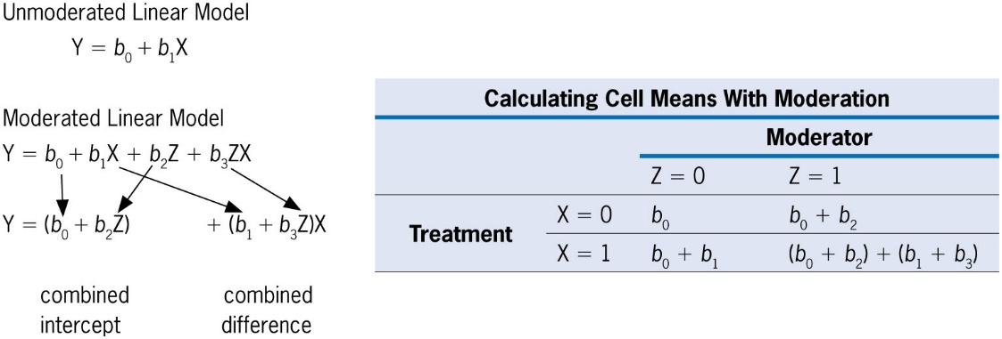
Interpreting Moderation
Extent to which a main effect may be contingent on a third variable—i.e., how the main effect varies for different values of the moderator
Impacts of Moderator Effects on Cell Means
For use with Hair, Black, Babin and Anderson, Multivariate Data Analysis 8e © 2018 Cengage Learning EMEA

Slide 46
Stage 6: Validation of the Results
For use with Hair, Black, Babin and Anderson, Multivariate Data Analysis 8e © 2018 Cengage Learning EMEA

Slide 47
Validating Experiments
Primary Approach: Replication
specificity of experimental treatments allows for a widespread use of the same experiment in multiple populations to assess the generalizability of the results.
Issues to Be Addressed
Comparability of research situations, particularly in terms of respondent samples
Consider use of covariates to control for sample differences outside scope of models tested.
Ensuring requirements for causal inference – even if causal inference is not intended, ensure that the basic elements (e.g., temporal ordering of treatments and outcomes) are maintained.
For use with Hair, Black, Babin and Anderson, Multivariate Data Analysis 8e © 2018 Cengage Learning EMEA

Slide 48
Advantages and Disadvantages of MANOVA
Advantages
Allows for testing two or more related dependent variables in a single analysis while accounting for their multicollinearity.
Controls for experiment-wide error rate that occurs from multiple ANOVA tests.
Can have more statistical power than univariate tests.
Can test for sequential orderings of dependent measures with stepdown analysis.
Disadvantages
Assumptions similar to discriminant analysis can be problematic.
While overall multivariate tests are performed, tests of relative impact of individual dependent measures are less well defined.
Requires increased sample size compared to separate ANOVAs.
Overall results can be distorted by inclusion of inappropriate dependent measures.
For use with Hair, Black, Babin and Anderson, Multivariate Data Analysis 8e © 2018 Cengage Learning EMEA

Slide 49
Advanced Issues: Causal Inference in Nonrandomized Situations
Causality in the Social and Behavioral Sciences
The Potential Outcomes Approach
Non-experimental Research Designs
Propensity Score Models
For use with Hair, Black, Babin and Anderson, Multivariate Data Analysis 8e © 2018 Cengage Learning EMEA

Slide 50
Causality in the Social and Behavioral Sciences
Controlled randomized experiments are considered the “gold standard” in estimating causal effects.
Estimating causal effects in non-experimental situations, such as observational data, has previously been thought impractical due to the inability to remove all of the confounding effects impacting the main effect.
Causal inferences are necessary outside the controlled experiment setting for many issues in which random assignment and manipulation of the treatment is not practical (e.g., health risks, naturally occurring phenomenon, etc.).
For use with Hair, Black, Babin and Anderson, Multivariate Data Analysis 8e © 2018 Cengage Learning EMEA

Slide 51
The Potential Outcomes Approach
Potential Outcomes framework (Rubin)
established a general framework encompassing both randomized experiments and non-experimental data for the purposes of making causal inferences.
When participants are assigned, they can be in only treatment or control, not both.
The counterfactual represents the outcomes expected of a participant if it was assigned to the other group (e.g., what would have happened to members of the control group if they were given the treatment).
For use with Hair, Black, Babin and Anderson, Multivariate Data Analysis 8e © 2018 Cengage Learning EMEA

Slide 52
Non-experimental Research Designs
Key Issues in causal inference from non-experimental situations
Similarity of Treatment and Control Groups
In order to approximate the comparability from random assignment to groups, must control for all possible effects on outcomes outside the main effect.
Confounding Variables
Greatest concern – the “unobserved common cause,” the presence of confounders biases the estimate of the main effect.
Confounders are a principal cause of endogeneity along with measurement error and simultaneity.
Assumption of Strongly Ignorable Treatment Assignment
All confounding or sources of endogeneity can be eliminated if there is equivalence on the set of potential confounding characteristics of the treatment and control groups.
Allows for a procedure to provide ignorability of endogenous effects given the appropriate identification and treatment of the potential confounding effects.
Balance
Must ensure the equivalence of the treatment and control groups on all potential confounders.
For use with Hair, Black, Babin and Anderson, Multivariate Data Analysis 8e © 2018 Cengage Learning EMEA

Slide 53
Propensity Score Models
Six Step Process
Step 1: Specify Covariates
Specify a covariate set including all of the known confounders and other variables related to the outcome (e.g., confounders and possibly covariates/blocking variables).
While an unlimited number of variables should not be included in the set of confounders, it is best to include variables if not certain about their effect.
Do not include variables that are mediators (i.e., are caused by the treatment) or variables that are highly associated with the treatment, but not the outcome.
Step 2: Estimate Propensity Score Model
The logistic regression model is not evaluated on how well it “predicts” the treatment variables, but rather on its ability to estimate a variate across all of the confounders that also has balance between treatment and control groups.
The predicted probability value is used as the propensity score, a single value that can be used to group observations with similar profiles across the variables in the model.
For use with Hair, Black, Babin and Anderson, Multivariate Data Analysis 8e © 2018 Cengage Learning EMEA

Slide 54
Propensity Score Models
Step 3: Estimate Balance of Covariate Set and Model Overlap
Fundamental objective of the propensity score model is to obtain balance (i.e., equivalence between the treatment and control groups across the variables included in the model.
Balance is achieved when there is no significant difference on any model in the variable between treatment and control groups.
Step 4: Application of Propensity Scores – form equivalent groups of observations in the treatment and control groups:
Matching involves matching observations from one group with observations from the opposite group based on equal or highly similar propensity scores.
Stratification involves forming subgroups of observations from the treatment and control groups which are similar on the propensity scores.
Weighting uses the inverse of the propensity score to weight individual observations before the causal effects are estimated.
For use with Hair, Black, Babin and Anderson, Multivariate Data Analysis 8e © 2018 Cengage Learning EMEA

Slide 55
Propensity Score Models
Step 5: Recheck Balance of Covariates
Ensure balance exists on all remaining covariates.
Step 6: Estimate Causal Effect
ATE (Average treatment effect of the treatment) -- the expected difference in the outcome
between treatment and control groups.
ATT (Average treatment effect for the treated) – the expected difference among only those
respondents who received the treatment.
ATT does not equal the ATE.
For use with Hair, Black, Babin and Anderson, Multivariate Data Analysis 8e © 2018 Cengage Learning EMEA

Slide 56
Illustration of a MANOVA Analysis
Example 1: Difference Between Two Independent Groups
Example 2: Difference Between K Independent Groups
Example 3: A Factorial Design for MANOVA with Two Independent Variables
Example 4: Moderation and Mediation
For use with Hair, Black, Babin and Anderson, Multivariate Data Analysis 8e © 2018 Cengage Learning EMEA

Slide 57
Four Research Questions
What differences are present in customer satisfaction and other purchase outcomes between the two channels in the distribution system?
Is HBAT establishing better relationships with its customers over time, as reflected in customer satisfaction and other purchase outcomes?
What is the relationship between the distribution system and these relationships with customers in terms of the purchase outcomes?
For any significant main effects found for the distribution system (X₅) with the purchase outcomes:
Do they vary by firm size (X₃)?
Does the percentage of a customer’s purchases from HBAT (X₂₂) play an intermediary role in the main effect on the purchase outcomes?
For use with Hair, Black, Babin and Anderson, Multivariate Data Analysis 8e © 2018 Cengage Learning EMEA

Slide 58
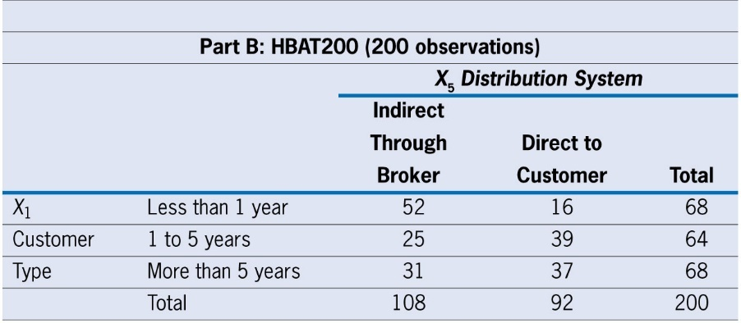
Research Design
Sample Size
HBAT200 used to ensure sufficient sample size in two factor analysis.
Variables
Independent variables – X₅ (Distribution System) and X₁ (Customer Type)
Outcome variables – X₁₉ Satisfaction; X₂₀ Likelihood of Recommending HBAT; and X₂₁ Likelihood of Future Purchase
Mediator (X₂₂) and Moderator (X₃)
For use with Hair, Black, Babin and Anderson, Multivariate Data Analysis 8e © 2018 Cengage Learning EMEA

Slide 59
Example 1: Difference Between Two Independent Groups
Research Question: What differences are present in customer satisfaction and other purchase outcomes between the two channels in the distribution system (X₅)?
Examining Group Profiles
Assumptions: All assumptions met at acceptable levels
For use with Hair, Black, Babin and Anderson, Multivariate Data Analysis 8e © 2018 Cengage Learning EMEA

Slide 60
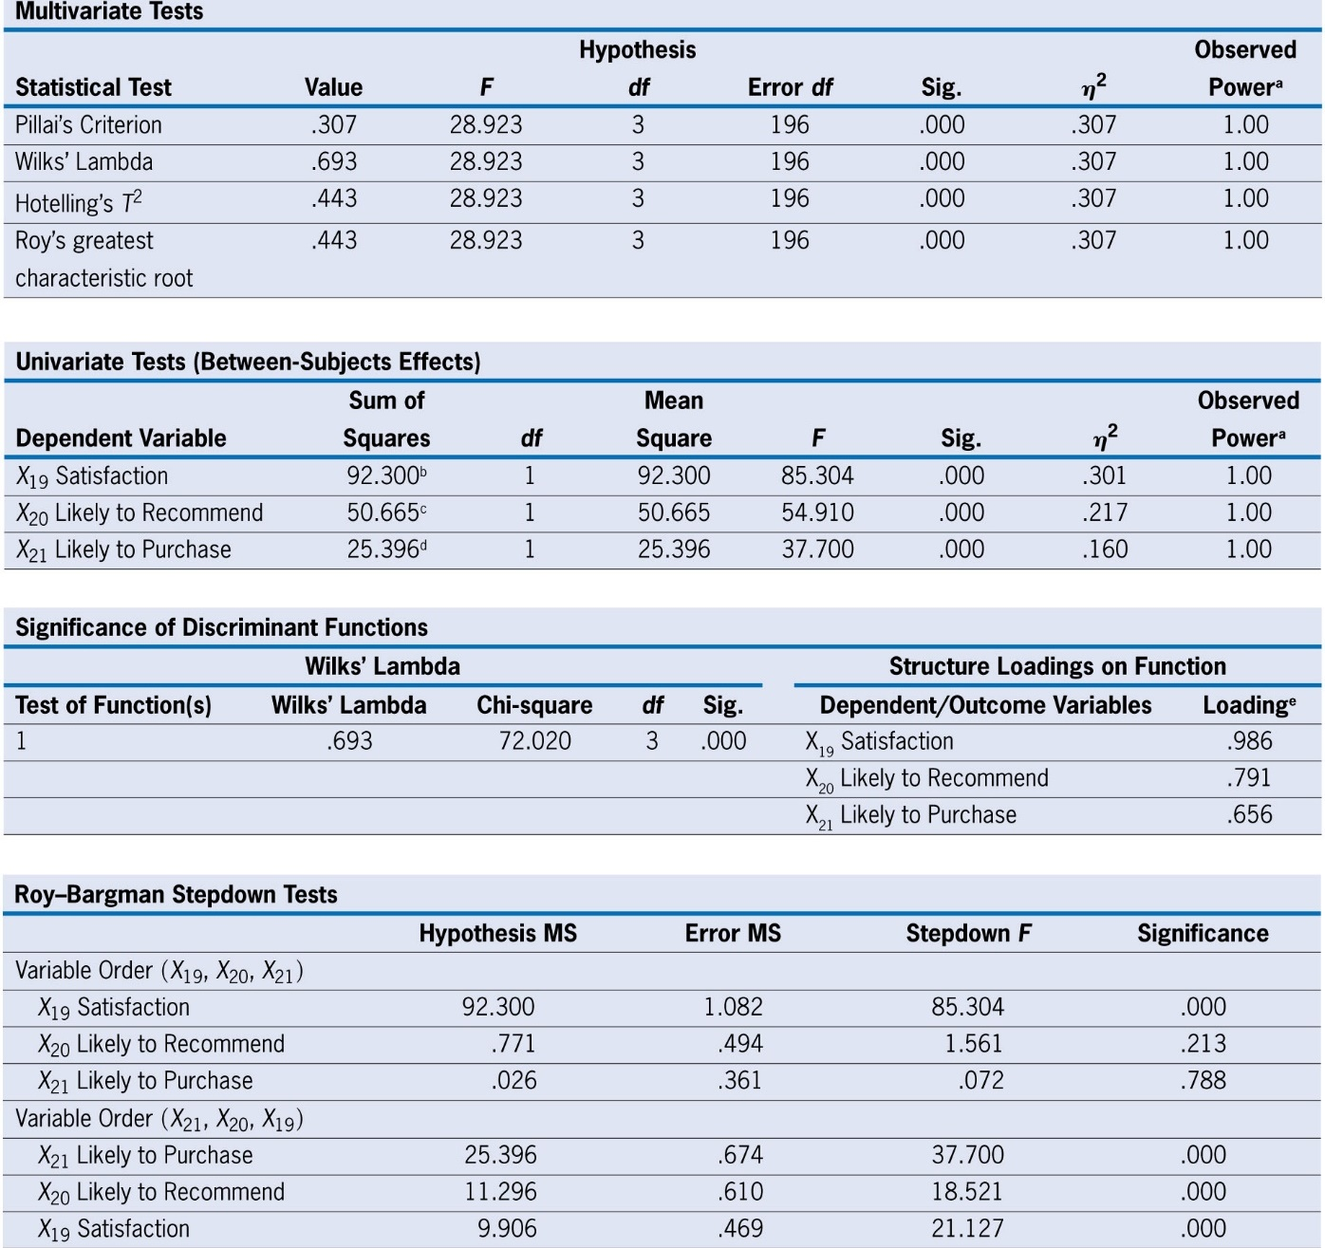
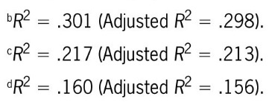
Multivariate and Univariate Tests for Group Differences
Impact of distribution system statistically significant, both overall (multivariate tests) and for each outcome separately.
Direct type of distribution system scored significantly higher than those serviced through the broker-based indirect distribution channel.
For use with Hair, Black, Babin and Anderson, Multivariate Data Analysis 8e © 2018 Cengage Learning EMEA

Slide 61
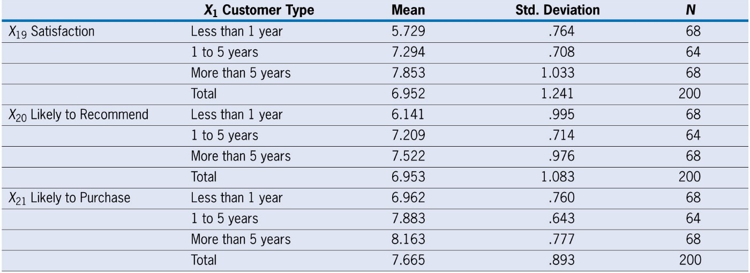
Example 2: Difference Between K Independent Groups
Research Question: Is HBAT establishing better relationships with its customers over time (X₁), as reflected in customer satisfaction and other purchase outcomes?
Examining Group Profiles
Assumptions: All assumptions met at acceptable levels.
For use with Hair, Black, Babin and Anderson, Multivariate Data Analysis 8e © 2018 Cengage Learning EMEA

Slide 62
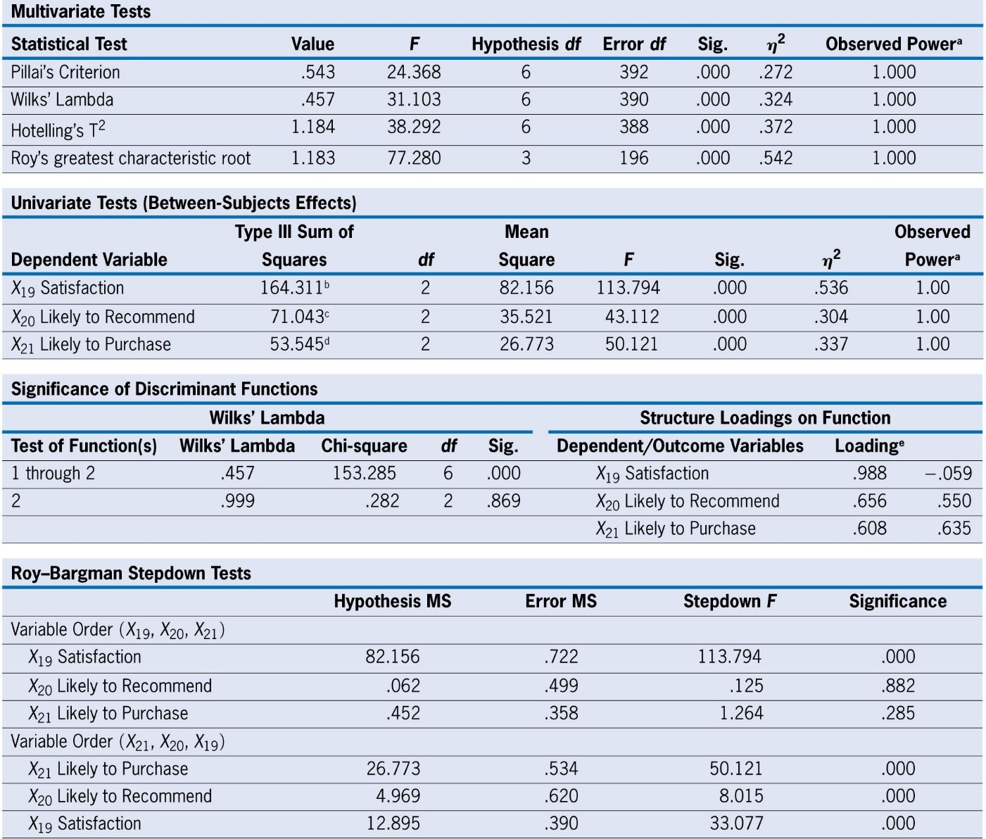
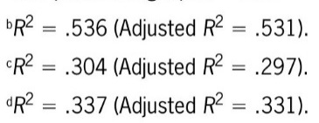
Multivariate and Univariate Tests for Group Differences
Impact of customer type (length of tenure) statistically significant, both overall (multivariate tests) and for each outcome separately.
Length of tenure increases all three purchase outcomes.
For use with Hair, Black, Babin and Anderson, Multivariate Data Analysis 8e © 2018 Cengage Learning EMEA

Slide 63
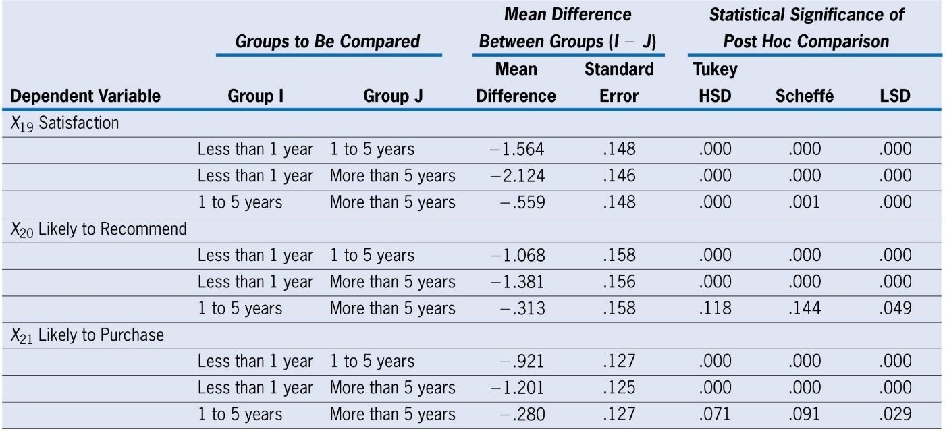
Comparing Individual Groups: Post Hoc Comparisons
X₁₉ (Satisfaction):
All group comparisons are significantly different.
X₂₀ (Likely to Recommend) and
X₂₁ (Likely to Purchase)
Significant differences. between Less than 1 year and 1 to 5 years.
No difference between 1 to 5 years and More than 5 years.
For use with Hair, Black, Babin and Anderson, Multivariate Data Analysis 8e © 2018 Cengage Learning EMEA

Slide 64
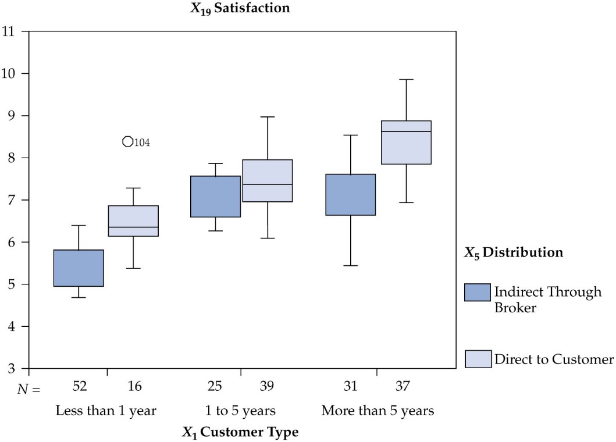
Example 3: A Factorial Design with Two Independent Variables
Basic Research Questions Addressed Jointly:
Is the direct distribution system more effective for newer customers?
Do the two distribution systems show differences for customers with longer tenure?
Is the direct distribution system always preferred over the indirect system across the customer groups of X₁?
Examining Group Profiles
for X₁₉ Satisfaction
Assumptions: All assumptions met at acceptable levels.
For use with Hair, Black, Babin and Anderson, Multivariate Data Analysis 8e © 2018 Cengage Learning EMEA

Slide 65
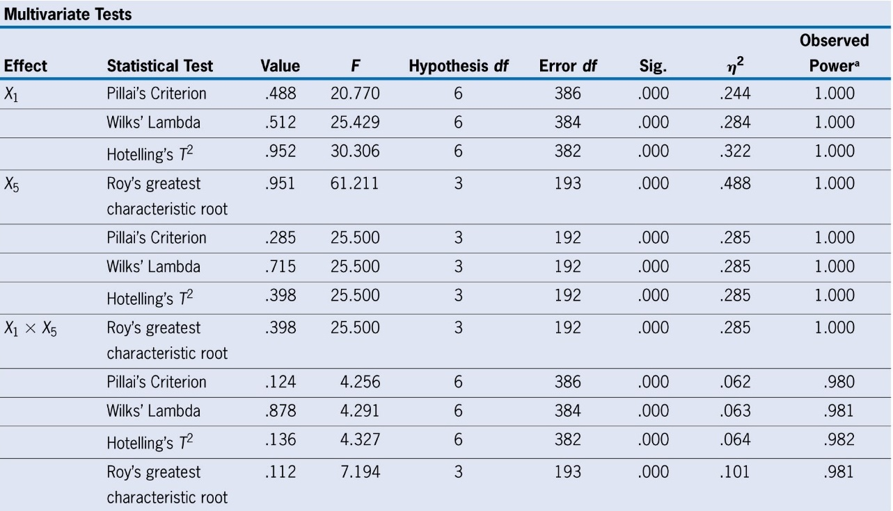
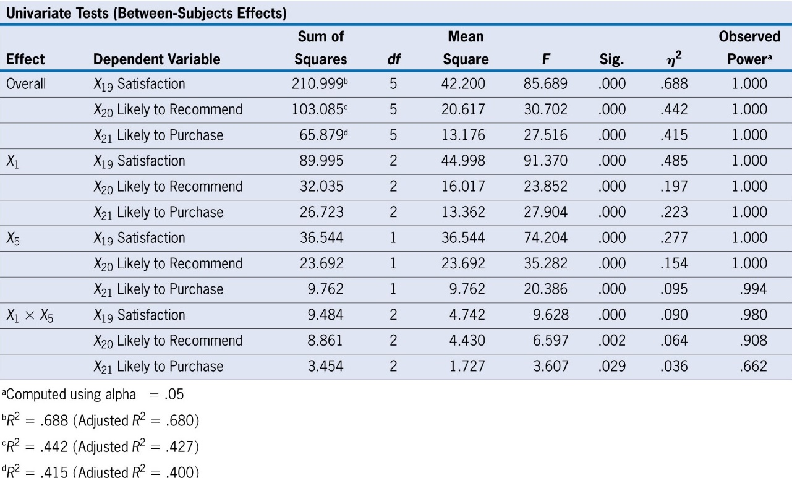
Multivariate and Univariate Tests for Group Differences
Statistical Significance Found For All Main Effects and Interactions
For use with Hair, Black, Babin and Anderson, Multivariate Data Analysis 8e © 2018 Cengage Learning EMEA

Slide 66
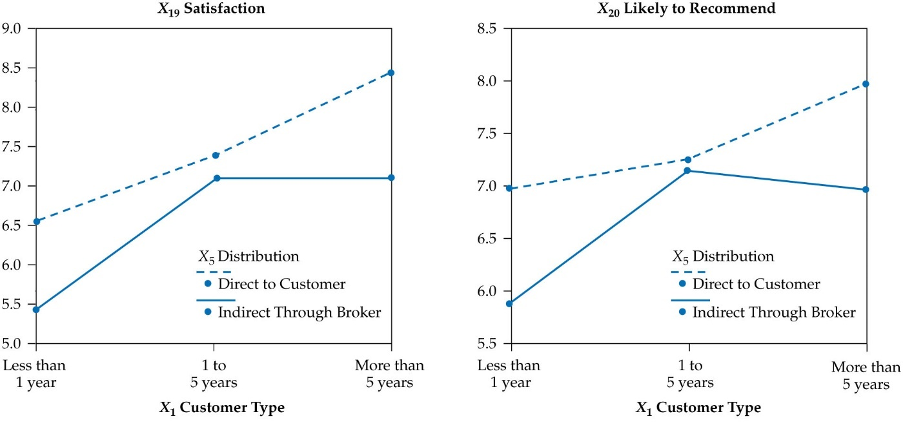
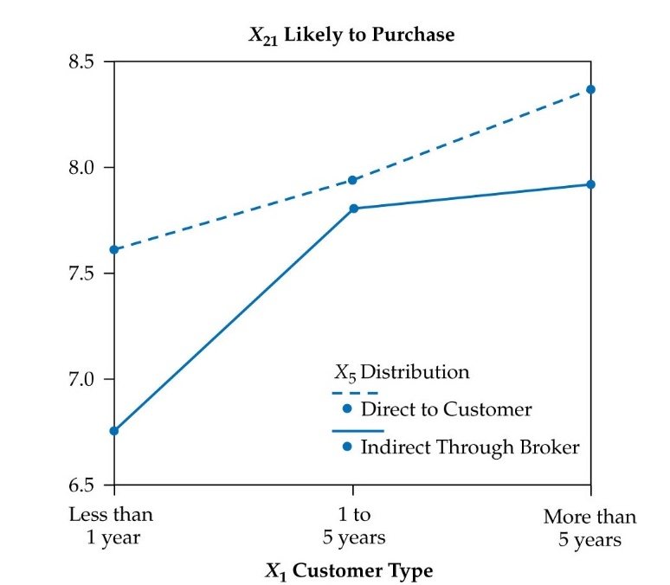
Interpreting Interactions
All Interactions are Statistically Significant and Ordinal
For use with Hair, Black, Babin and Anderson, Multivariate Data Analysis 8e © 2018 Cengage Learning EMEA

Slide 67
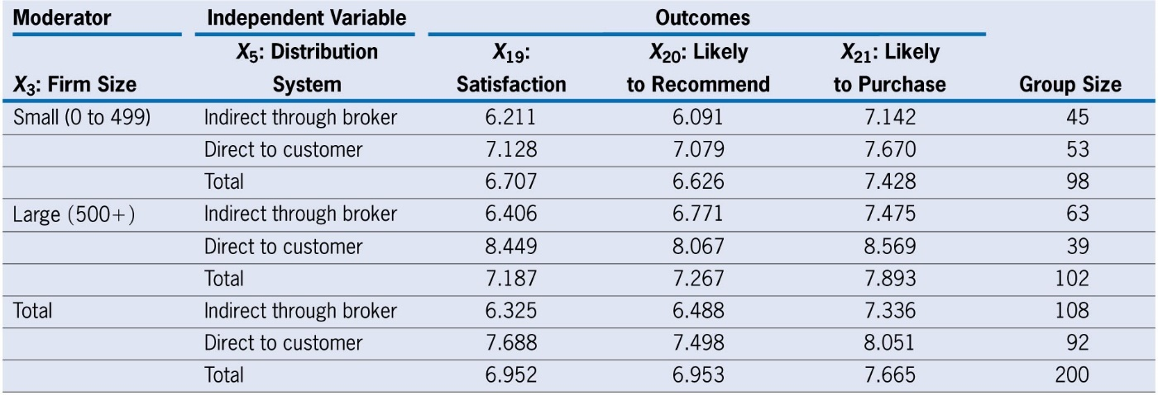
Example: Moderation of Distribution System (X5) by Firm Size (X3)
Research Question:
Possibility that the operation and management of the distribution system may impact firms differently based on their size.
Examining Group Profiles
Assumptions: All assumptions met at acceptable levels
For use with Hair, Black, Babin and Anderson, Multivariate Data Analysis 8e © 2018 Cengage Learning EMEA

Slide 68
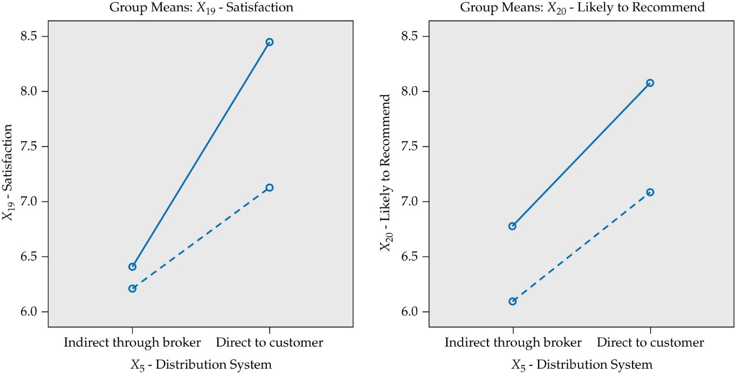
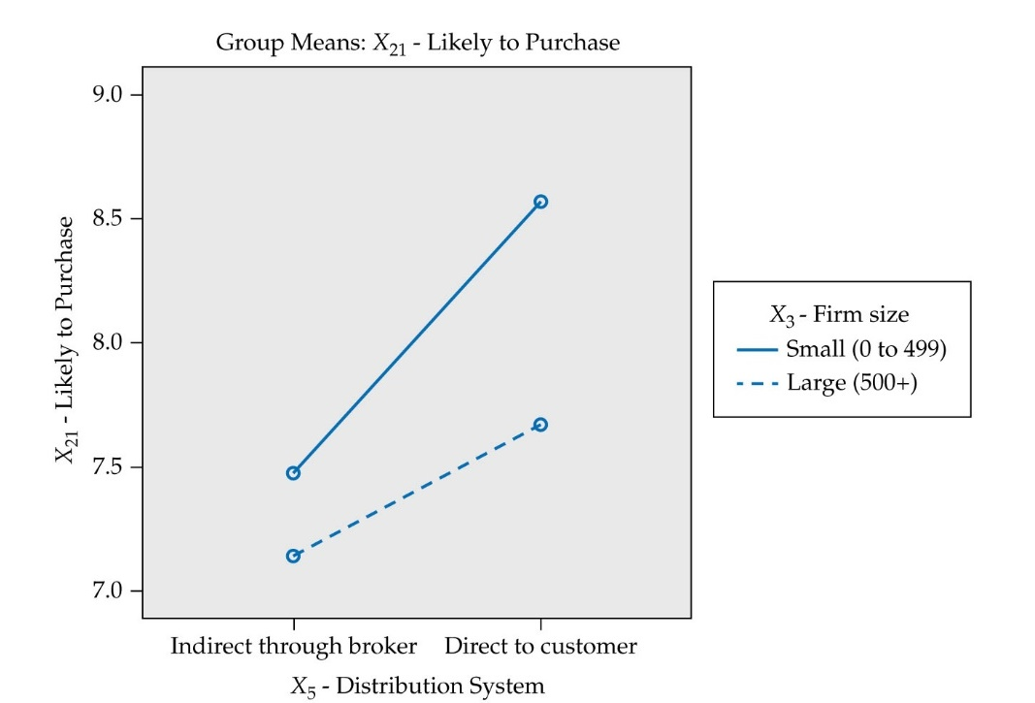
Graphical Portrayal of Moderator Effect
For use with Hair, Black, Babin and Anderson, Multivariate Data Analysis 8e © 2018 Cengage Learning EMEA

Slide 69
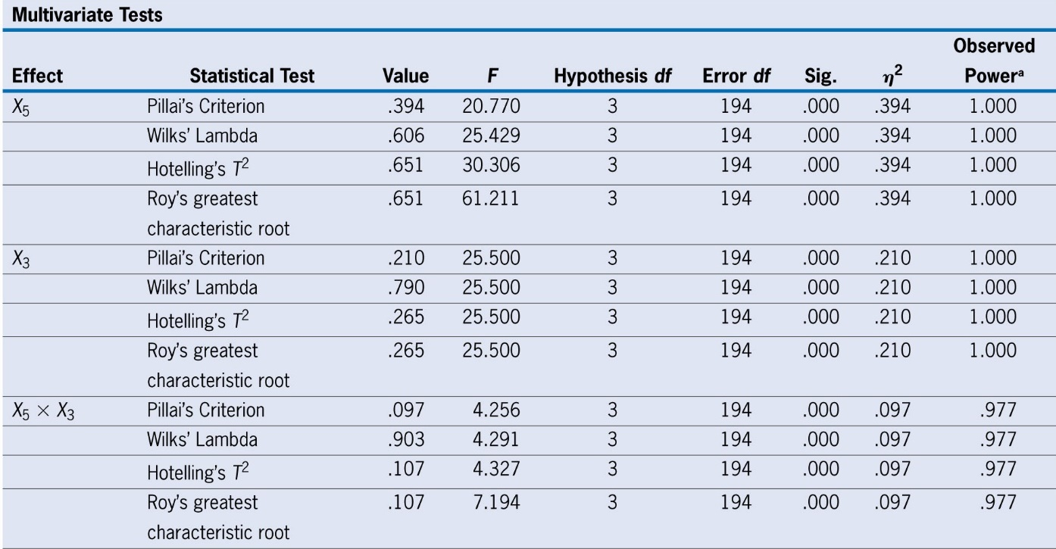
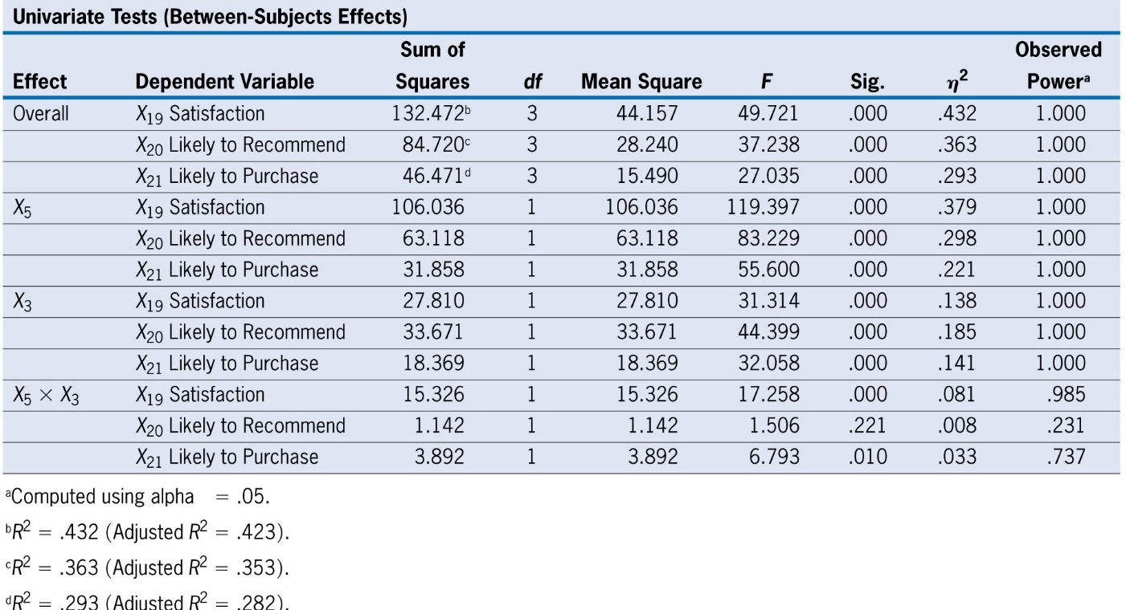
Multivariate and Univariate Tests for Moderation
All Main Effects and Moderation Effects (except for X₂₀) are Statistically Significant
For use with Hair, Black, Babin and Anderson, Multivariate Data Analysis 8e © 2018 Cengage Learning EMEA

Slide 70
Research Question:
Can the effect of X₅ (Distribution System) be “explained” by the impact of X₂₂ (Purchase Level)?
For use with Hair, Black, Babin and Anderson, Multivariate Data Analysis 8e © 2018 Cengage Learning EMEA

Slide 71
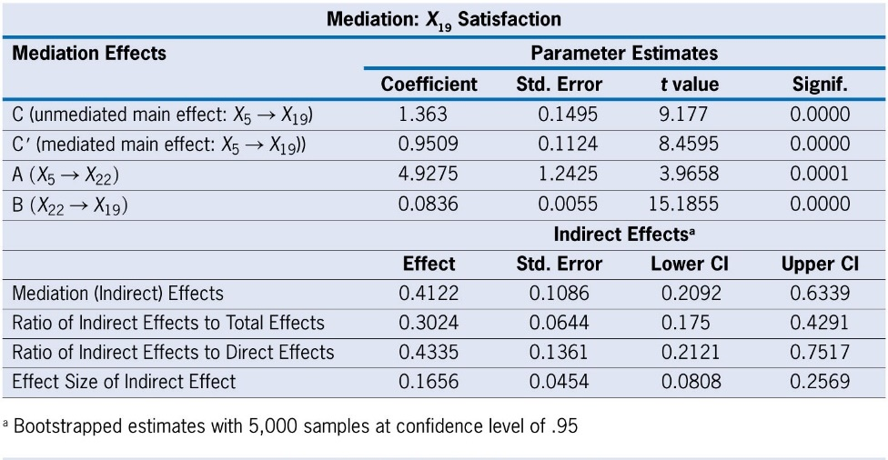
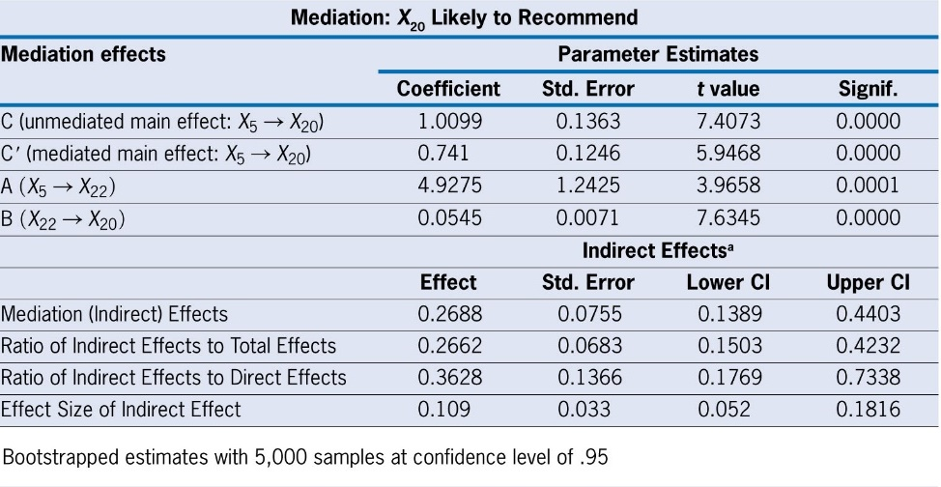
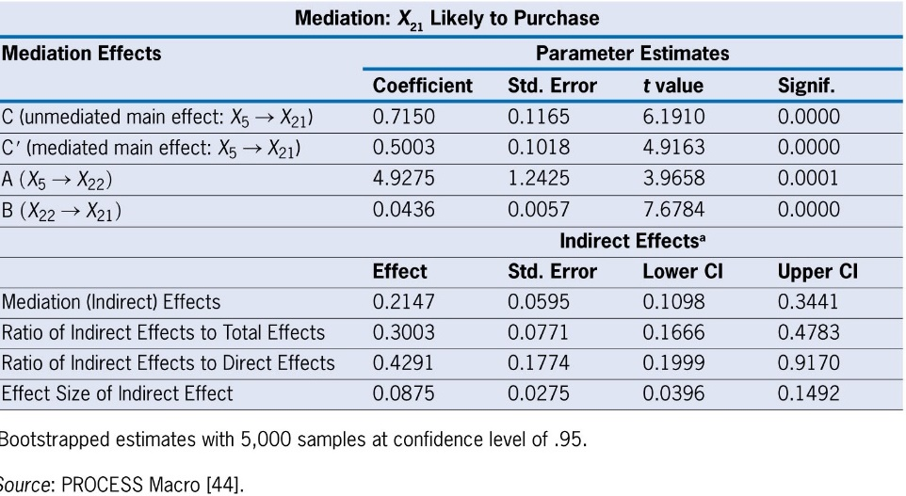
Example: Mediation of Distribution System (X₅) By Purchase Level (X₂₂)
Research Question:
Can the effect of X₅ (Distribution System) be “explained” by the impact of X₂₂?
Interpretation of the mediation effects
There is a substantial mediation effect working through X22, typically accounting for about 30 percent of the total effect of X5 on the outcome. The effect sizes are what would generally be characterized as medium in terms of their size.
Only partial mediation was achieved, since in each instance the mediated main effect was highly significant and still accounted for a majority of the overall effect.
For use with Hair, Black, Babin and Anderson, Multivariate Data Analysis 8e © 2018 Cengage Learning EMEA

