Slide 1
Chapter 13: Partial Least Squares Structural Equation Modeling (PLS-SEM)
For use with Hair, Black, Babin and Anderson, Multivariate Data Analysis 8e © 2018 Cengage Learning EMEA

Slide 2
Learning Objectives
Upon completing this chapter, you should be able to do the following:
Understand the distinguishing characteristics of PLS-SEM.
Explain how the PLS-SEM algorithm is estimated.
Describe the stages of the PLS-SEM decision process.
Distinguish between common factor modeling and composite modeling.
Explain how to assess reflective and formative measurement models.
Interpret the results of the HBAT data used with PLS-SEM.
Describe when PLS-SEM and CB-SEM are the appropriate structural modeling method.
For use with Hair, Black, Babin and Anderson, Multivariate Data Analysis 8e © 2018 Cengage Learning EMEA

Slide 3
Overview
What is PLS-SEM?
Estimation of Path Models with PLS-SEM
PLS-SEM Decision Process
Stage 1: Defining Research Objectives and Selecting Constructs
Stage 2: Designing a Study to Produce Empirical Results
Stage 3: Specifying the Measurement and Structural Models
Stage 4: Assessing Measurement Model Validity
Stage 5: Assessing the Structural Model
Stage 6: Advanced Analyses Using Pls-SEM
PLS-SEM Illustration
For use with Hair, Black, Babin and Anderson, Multivariate Data Analysis 8e © 2018 Cengage Learning EMEA

Slide 4
What is PLS-SEM?
Structural Model
Measurement Model
Theory and Path Models in PLS-SEM
The Emergence of SEM
Role of PLS-SEM Versus CB-SEM
For use with Hair, Black, Babin and Anderson, Multivariate Data Analysis 8e © 2018 Cengage Learning EMEA

Slide 5
What is PLS-SEM and Why Use It?
What is it?
PLS-SEM = a method of structural equation modeling that executes two types of analysis simultaneously. The first type of analysis is Confirmatory Composite Analysis (CCA), which is similar to principal components analysis (PCA). The second type of analysis is structural model assessment and it is similar to multiple regression. In obtaining an optimum solution these two types of analysis assess the measurement model (CCA) and the structural model, based on the primary objective of prediction of the variance in the dependent variable(s).
Why use it?
Assess the measurement quality of multi-item concepts/constructs
Predict one or more outcome variables/constructs
Hypothesis testing
For use with Hair, Black, Babin and Anderson, Multivariate Data Analysis 8e © 2018 Cengage Learning EMEA

Slide 6
Basic Concepts of PLS-SEM
Measurement Model (outer model) = how measured variables represent the variables/constructs.
Structural Model (inner model) = how constructs are associated with each other.
Path Model (diagram) = a visual representation of your theory.
Theory = a systematic set of relationships providing a consistent and comprehensive explanation of phenomena.
For use with Hair, Black, Babin and Anderson, Multivariate Data Analysis 8e © 2018 Cengage Learning EMEA

Slide 7
PLS-SEM/CB-SEM versus Other Multivariate Methods
 | Primarily Exploratory | Primarily Confirmatory
First Generation Methods | Cluster analysis Exploratory Factor Analysis (EFA) Multidimensional Scaling | Analysis of Variance (ANOVA) MANOVA Multiple Regression Logistic Regression Discriminant Analysis
Second Generation Methods | PLS-SEM | CB-SEM
For use with Hair, Black, Babin and Anderson, Multivariate Data Analysis 8e © 2018 Cengage Learning EMEA

Slide 8
PLS-SEM versus CB-SEM
● CB-SEM: Prediction is possible with covariance-based structural modeling, the primary statistical objective of CB-SEM is confirming theory by estimating a new covariance matrix that is not significantly different from the original observed covariance matrix. CB-SEM uses a common-factor approach to developing proxies for constructs.
● PLS-SEM: The primary statistical objective of PLS-SEM is prediction that maximizes the explained variance in the dependent variable(s). PLS-SEM calculates composites for the latent variables. The composites are estimated as exact linear combinations of their indicators that maximize the variance extracted from the exogenous construct indicators that is useful for predicting the endogenous construct(s) indicators.
For use with Hair, Black, Babin and Anderson, Multivariate Data Analysis 8e © 2018 Cengage Learning EMEA

Slide 9
Comparing PLS-SEM With CB-SEM
PLS-SEM | CB-SEM
Estimates model parameters to maximize explained variance in endogenous constructs. | Estimates model parameters so the differences between the sample and estimated covariance matrices is minimized.
No distribution assumptions. | Assumes multivariate normality.
Works well with small sample sizes (<100). | Requires large sample sizes (minimum 100; preferred 200+).
Defines convergence at the point at which no substantial improvement in prediction is possible. | Maximum-likelihood estimation of model parameters
No established goodness-of-fit statistics. | Has goodness-of-fit statistics (GOF)
Treats constructs as composites – total variance is used to estimate model parameters. | Treats constructs as common factors – only common variance is used to estimate model parameters
For use with Hair, Black, Babin and Anderson, Multivariate Data Analysis 8e © 2018 Cengage Learning EMEA

Slide 10
CB-SEM dominant 2nd generation approach, but PLS-SEM applications have been increasing rapidly . . .
For use with Hair, Black, Babin and Anderson, Multivariate Data Analysis 8e © 2018 Cengage Learning EMEA

Slide 11
PLS-SEM Decision Process
Stage 1: Defining research objectives and selecting constructs.
Stage 2: Designing a study to produce empirical results.
Stage 3: Specifying the measurement and structural models.
Stage 4: Assessing measurement model validity.
Stage 5: Assessing the structural model.
Stage 6: Advanced analyses with PLS-SEM
For use with Hair, Black, Babin and Anderson, Multivariate Data Analysis 8e © 2018 Cengage Learning EMEA

Slide 12
Stage 1: Defining research objectives and selecting constructs
For use with Hair, Black, Babin and Anderson, Multivariate Data Analysis 8e © 2018 Cengage Learning EMEA

Slide 13
Confirmatory Versus Exploratory Research
Confirmatory Research
Confirm theoretical measurement models and structural model relationships
Requires we-developed theory
Exploratory Research involves at least three situations . . .
Less well-defined research problems
Used to generate hypotheses
Useful for all types of research questions – what, when, why and how
CB-SEM -- generally restricted to confirmatory research
PLS-SEM – applicable in both situations, especially exploratory research and when prediction is desired
For use with Hair, Black, Babin and Anderson, Multivariate Data Analysis 8e © 2018 Cengage Learning EMEA

Slide 14
Stage 2: Designing a study to produce empirical results.
Metric versus nonmetric data and multivariate normality
Missing data
Statistical power
Model complexity and sample size
For use with Hair, Black, Babin and Anderson, Multivariate Data Analysis 8e © 2018 Cengage Learning EMEA

Slide 15
Issue in Research Design
Metric versus nonmetric data and multivariate normality
non-parametric method allows for
nonmetric data types (nominal or ordinal) in addition to metric data.
good solutions with non-normal data and when heteroscedasticity is present
Especially suitable for survey data and for secondary (archival) data.
Missing data
Must address extent and randomness of missing data before model estimation (see Chapters 2 and 9)
Statistical power
Higher statistical power than CB-SEM, thus particularly suitable for exploratory research with less developed theory and smaller sample sizes.
For use with Hair, Black, Babin and Anderson, Multivariate Data Analysis 8e © 2018 Cengage Learning EMEA

Slide 16
Model Complexity and Sample Size
Sample Size depends on . . .
Number of constructs.
Number of indicators per construct.
Number of observations per estimated parameter.
Uses OLS regressions to estimate the model’s partial regression relationships.
The recommended sample size should be based on statistical power considerations and the context of the research.
In general, larger sample sizes (>100) are preferable, but smaller sample sizes (<100) are acceptable depending on the context of the research; e.g., B-to-B research that is restricted to smaller populations will necessarily involve smaller sample sizes.
For use with Hair, Black, Babin and Anderson, Multivariate Data Analysis 8e © 2018 Cengage Learning EMEA

Slide 17
Sample Size: 10 Times Rule
The 10 times rule indicates the sample size should be equal to the larger of:
10 times the largest number of formative indicators used to measure a single construct, or
10 times the largest number of structural paths directed at a particular latent construct in the structural model.
Equivalent to saying that the minimum sample size should be 10 times the maximum number of arrowheads pointing at a latent variable anywhere in the path model.
While the 10 times rule offers a rough guideline for minimum sample size, PLS-SEM – like any statistical technique – requires researchers to consider the sample size against the background of the model and data characteristics.
Specifically, the required sample size should be determined using power analyses based on the part of the model with the largest number of predictors.
For use with Hair, Black, Babin and Anderson, Multivariate Data Analysis 8e © 2018 Cengage Learning EMEA

Slide 18
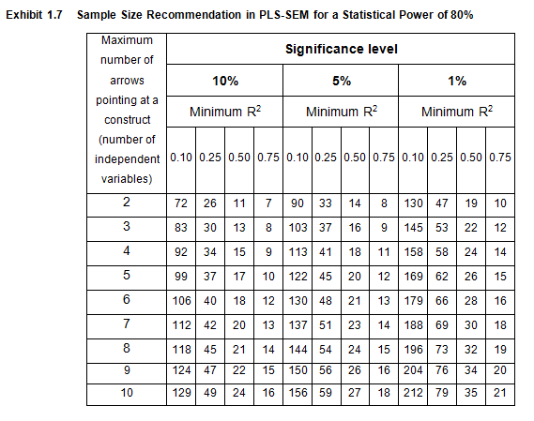
PLS-SEM Sample Size Based on Statistical Power (80%)
Source: Hair, Hult, Ringle & Sarstedt, A Primer in Partial Least Squares Structural Equation Modeling (PLS-SEM), Sage, 2nd Edition, 2017, p. 26.
For use with Hair, Black, Babin and Anderson, Multivariate Data Analysis 8e © 2018 Cengage Learning EMEA

Slide 19
Stage 3: Specifying the Measurement and Structural Models
PLS-SEM Path Model
Measurement Theory and Models – Reflective versus Formative
For use with Hair, Black, Babin and Anderson, Multivariate Data Analysis 8e © 2018 Cengage Learning EMEA

Slide 20
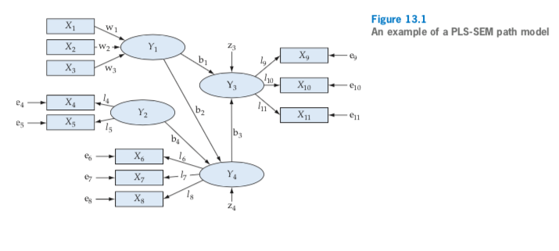
PLS-SEM Path Model
Structural Model
Measurement Model
For use with Hair, Black, Babin and Anderson, Multivariate Data Analysis 8e © 2018 Cengage Learning EMEA

Slide 21
Reflective vs. Formative Measurement Models
A central research question in social science research focuses
on the operationalization of complex constructs:
Are indicators causing or being caused by
the latent variable/construct measured by them?
Indicator 1
Indicator 2
Indicator 3
Indicator 1
Indicator 2
Indicator 3
Construct
?
Construct
Changes in the latent variable directly cause changes in the assigned indicators
Changes in one or more of the indicators causes changes in the latent variable
For use with Hair, Black, Babin and Anderson, Multivariate Data Analysis 8e © 2018 Cengage Learning EMEA

Slide 22
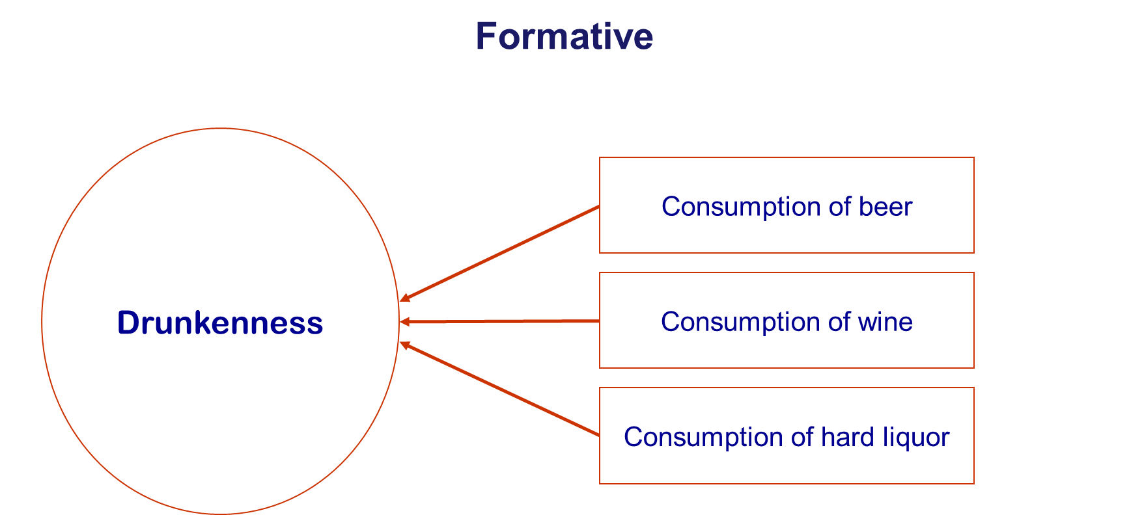
Example: Reflective vs. Formative World View
For use with Hair, Black, Babin and Anderson, Multivariate Data Analysis 8e © 2018 Cengage Learning EMEA

Slide 23
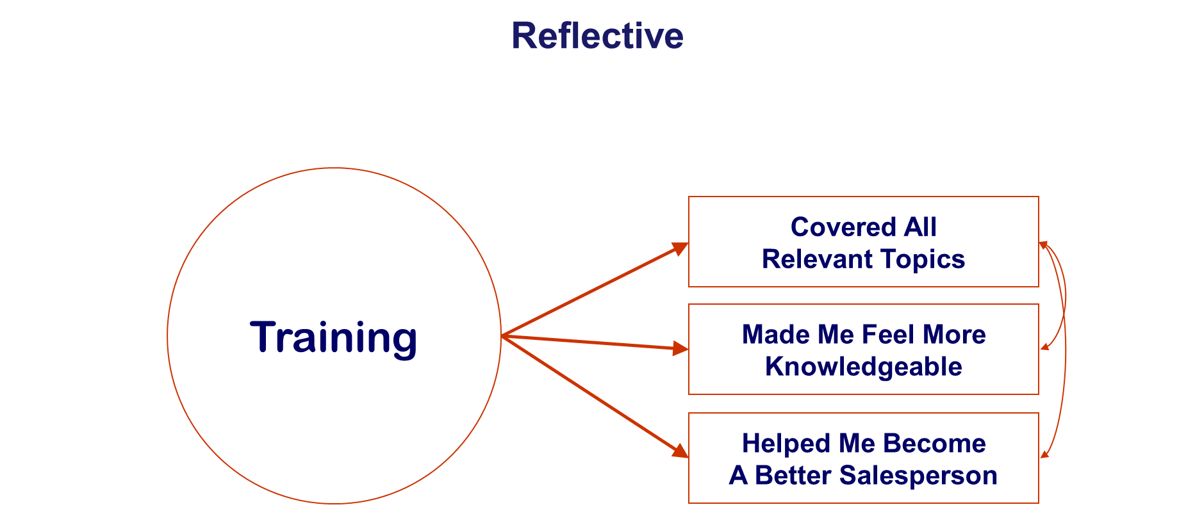
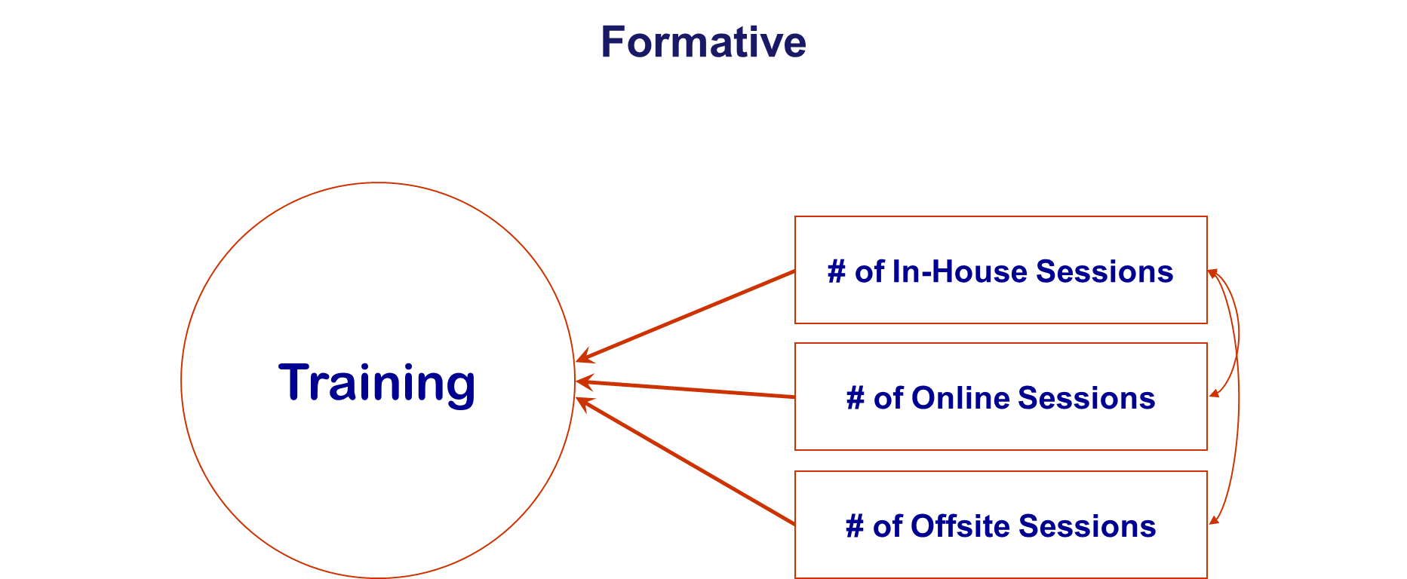
Example: Reflective vs. Formative World View
For use with Hair, Black, Babin and Anderson, Multivariate Data Analysis 8e © 2018 Cengage Learning EMEA

Slide 24
Stage 4: Assessing Measurement Model Validity
Assessing Reflective Measurement Models
Assessing Formative Measurement Models
Measurement Model Interpretation Metrics
For use with Hair, Black, Babin and Anderson, Multivariate Data Analysis 8e © 2018 Cengage Learning EMEA

Slide 25
Assessing Reflective Measurement Models
Indicator Loadings – recommended minimum 0.708
Construct Reliability – minimum .70
Convergent Validity – AVE at least .50
Discriminant Validity – HTMT (heterotrait-monotrait ratio)
For use with Hair, Black, Babin and Anderson, Multivariate Data Analysis 8e © 2018 Cengage Learning EMEA

Slide 26
Assessing Formative Measurement Models
Convergent Validity
Indicator Multicollinearity – should be minimal
Size and Statistical Significance of Indicator Weights
In relevant situations, Size and Significance of Indicator Loadings
For use with Hair, Black, Babin and Anderson, Multivariate Data Analysis 8e © 2018 Cengage Learning EMEA

Slide 27
Formative Measurement Models: Absolute Contribution of Indicators
Do not automatically remove an indicator if the weight (coefficient) is not statistically significant.
When an indicator weight is not significant, the indicator is retained if the bivariate correlation (loading) is 0.50 or higher. In general, empirical support for retaining indicators is not sufficient and keeping the indicator should also be based on theory and expert judgment.
If the indicator weight is not significant and the bivariate correlation (loading) is below 0.50, the indicator has no empirical support to keep it and should be removed from the measurement model.
For use with Hair, Black, Babin and Anderson, Multivariate Data Analysis 8e © 2018 Cengage Learning EMEA

Slide 28
PLS-SEM Measurement Model Interpretation Metrics
For use with Hair, Black, Babin and Anderson, Multivariate Data Analysis 8e © 2018 Cengage Learning EMEA

Slide 29
Stage 5: Assessing the Structural Model
Collinearity among Predictor Constructs
Examining the Coefficient of Determination
Effect Size
Blindfolding
Size and Significance of Path Coefficients
For use with Hair, Black, Babin and Anderson, Multivariate Data Analysis 8e © 2018 Cengage Learning EMEA

Slide 30
Structural Model Assessment
Assess collinearity among Predictor Constructs.
Examine the Coefficient of Determination (R²).
Evaluate the Effect Size (f2).
Blindfolding (cross-validated redundancy) – Q2 > zero.
Size and Statistical Significance of Path Coefficients.
Goodness of fit measures like χ2, GFI, CFI, RMSEA, and similar heuristics that are used with CB-SEM do not apply with PLS-SEM.
For use with Hair, Black, Babin and Anderson, Multivariate Data Analysis 8e © 2018 Cengage Learning EMEA

Slide 31
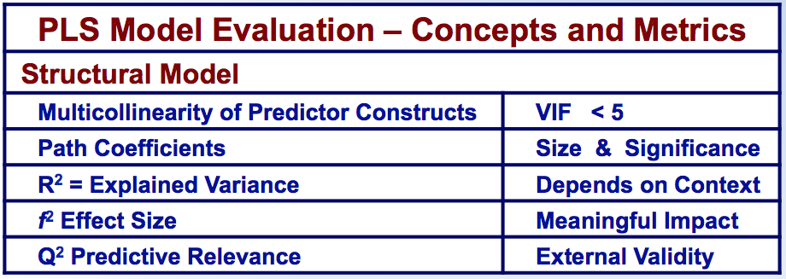
PLS-SEM Structural Model Interpretation Metrics
For use with Hair, Black, Babin and Anderson, Multivariate Data Analysis 8e © 2018 Cengage Learning EMEA

Slide 32
Stage 6: Advanced Analyses Using Pls-Sem
For use with Hair, Black, Babin and Anderson, Multivariate Data Analysis 8e © 2018 Cengage Learning EMEA

Slide 33
Advanced Analyses in PLS-SEM
Multi-Group Analysis (MGA) of observed heterogeneity
Detecting unobserved heterogeneity
Confirmatory Tetrad Analysis
Mediation Effects
Moderation
Higher Order Measurement Models
PLS Predict
For use with Hair, Black, Babin and Anderson, Multivariate Data Analysis 8e © 2018 Cengage Learning EMEA

Slide 34
PLS-SEM Illustration
For use with Hair, Black, Babin and Anderson, Multivariate Data Analysis 8e © 2018 Cengage Learning EMEA

Slide 35
Theoretical Employee Retention Path Model
For use with Hair, Black, Babin and Anderson, Multivariate Data Analysis 8e © 2018 Cengage Learning EMEA

Slide 36
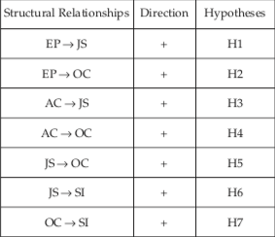
Structural Model Paths and Hypotheses
For use with Hair, Black, Babin and Anderson, Multivariate Data Analysis 8e © 2018 Cengage Learning EMEA

Slide 37
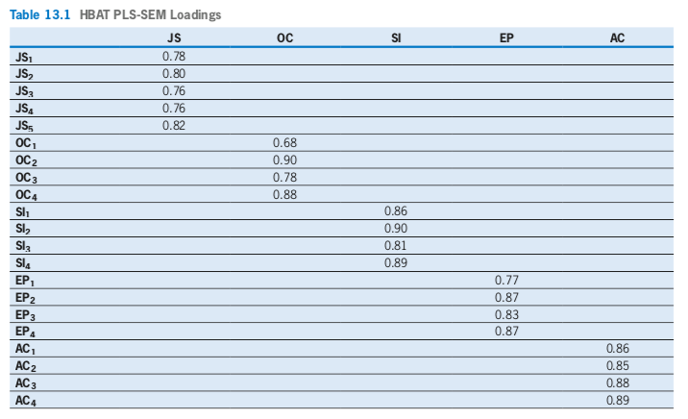
HBAT Results for PLS-SEM – Indicator Loadings
For use with Hair, Black, Babin and Anderson, Multivariate Data Analysis 8e © 2018 Cengage Learning EMEA

Slide 38
PLS-SEM an CB-SEM Results Comparison
For use with Hair, Black, Babin and Anderson, Multivariate Data Analysis 8e © 2018 Cengage Learning EMEA

Slide 39
HBAT Discriminant Validity – Fornell-Larcker Results
For use with Hair, Black, Babin and Anderson, Multivariate Data Analysis 8e © 2018 Cengage Learning EMEA

Slide 40
HBAT Discriminant Validity – HTMT Results
For use with Hair, Black, Babin and Anderson, Multivariate Data Analysis 8e © 2018 Cengage Learning EMEA

Slide 41
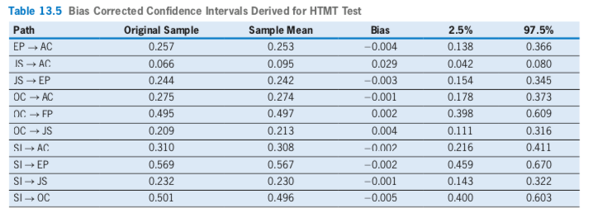
Bias Corrected HBAT Confidence Intervals
For use with Hair, Black, Babin and Anderson, Multivariate Data Analysis 8e © 2018 Cengage Learning EMEA

Slide 42
HBAT Construct Latent Variable Scores Correlations
For use with Hair, Black, Babin and Anderson, Multivariate Data Analysis 8e © 2018 Cengage Learning EMEA

Slide 43
HBAT Structural Model Results
For use with Hair, Black, Babin and Anderson, Multivariate Data Analysis 8e © 2018 Cengage Learning EMEA

Slide 44
HBAT Path Coefficients and f ² Effect Sizes
For use with Hair, Black, Babin and Anderson, Multivariate Data Analysis 8e © 2018 Cengage Learning EMEA

Slide 45
PLS-SEM Learning Checkpoint
When should PLS-SEM be used?
Why should PLS-SEM be used instead of CB-SEM?
What sample size is appropriate for PLS-SEM vs. CB-SEM?
What metrics are used to evaluate measurement model results?
How does Confirmatory Composite Analysis (CCA) compare to Confirmatory Factor Analysis (CFA)?
What metrics are used to evaluate PLS-SEM structural model results? How do PLS-SEM structural model evaluation metrics compare to the model evaluation metrics of CB-SEM.
For use with Hair, Black, Babin and Anderson, Multivariate Data Analysis 8e © 2018 Cengage Learning EMEA

