Slide 1
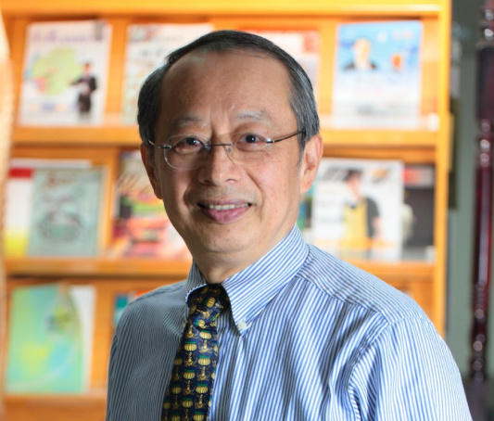
資管博士養成之分享
李有仁講座教授
國立中正大學資訊管理學系
https://eli.johogo.com
國立中山大學 ICIM 2023 研討會
2023/06/17

Slide 2
大綱
博士養成目標與衡量
雙理論之養成模式
Job Performance Theory: JP = f (O, C, W)
Field Theory: B = f (P, E)
養成過程
畢業與就業
結論與建議

Slide 3
目標與衡量
目標
Academia PhD vs. Industry DBA
Teaching vs. Research
Coursework vs. Publication
Technical vs. Organizational
衡量
Quality vs. Quantity
Qualifying exam vs. Journal paper
Professional activities
Teaching experience

Slide 4
雙理論之養成模式
Job Performance Theory: JP = f (O, C, W)
Opportunity
Capability
Job performance
Willingness

Slide 5
雙理論之養成模式
Field Theory: B = f (P, E)
Environment
Behavior
Person

Slide 6
養成過程
Academia PhD vs. Industry DBA
Teaching vs. Research
Coursework vs. Publication
Technical vs. Organizational
Quality vs. Quantity
Qualifying exam vs. Journal paper
Professional activities
Teaching experience

Slide 7
養成過程
Li, E.Y. (2023.3). How to Master the Quality and Quantity of Academic Publishing 如何掌握學術發表之質與量. Humanities and Social Sciences Newsletter Quarterly 人文與社會科學簡訊 (in Chinese) (NSTC, Taiwan), 24 (2), 65-68. (Table of Contents)

Slide 8
畢業與就業
畢業
Discipline knowledge?
Sufficient achievement?
Teaching experience?
English proficiency?
就業
Teaching or research institution?
English teaching required?
Publication required?
Discipline matched?
Attractive curriculum vita?
Worldwide placement?

Slide 9
結論與建議
Where there is a will, there is a way.
Be serious but stay loose
Be confident but know your limit
Be independent but find your people

Slide 10
Thank You for Listening
Q & A

