Slide 1
Do organizational citizenship behaviors lead to information system success?
Eldon Y. Li
Chair Professor
Department of IM
National Chung Cheng University, Taiwan
http://eli.johogo.com
*** All right reserved. Video or audio recording is permitted under CC BY-NC 4.0 License. This lecture is based on “Yen, H.J.R.*, Li, E.Y., and Niehoff, B. (2008.9). Do Organizational Citizenship Behaviors Lead to Information System Success? Testing the Mediation Effects of Integration Climate and Project Management. Information & Management (Elsevier), 45 (6), 394-402. (SSCI).

Slide 2
Agenda
Introduction
Research issues
Background
Literature review
Research Model
Method
Measures
Data representativeness
Scale assessment
Validation
Comparative models
Conclusions

Slide 3
Introduction
Over 50% of Information System Projects failed (Standish, 2003)
The success/failure of Information System Project as an indicator organizational performance
The importance of integrating the social-psychological perspective to explain and predict Information System Success (ISS)

Slide 4
Research Issues
Organizational Citizenship Behavior (OCB) as a potential influence of IS Success (ISS).
To explore the potential mediators for the OCB-ISS relationship.
To construct a framework explaining the impacts of OCB on ISS.

Slide 5
Background
Defining OCB (Organ 1988)
“individual behavior that is discretionary, not directly or explicitly recognized by the formal reward system, and that in the aggregate promotes the effective functioning of the organization.”
Few, if any studies have tried to understand how OCB might influence organizational performance outcomes. (Niehoff, 2004; Podsakoff, et al. 2000)

Slide 6
Background
OCB allows the organization to adapt more effectively to environmental changes and enhance the management productivity (Podsakoff and MacKenzie, 1997), leading to improved ISS.

Slide 7
Background
Implementation Team’s OCB
Organizational Performance Outcome –
Information System Success
Helping
Sportsmanship
Civic Virtue

Slide 8
Background
OCB may influence important organizational outcomes through the mediating variables of work facilitation and socio-emotional support (Niehoff, 2004)
Project management is related to the success of IS implementation (Holland and Light, 1999; Umble et al., 2003; Kumar et al., 2003)

Slide 9
Background
Climate perceptions are associated with a variety of important work outcomes at the individual (e.g., Brown & Leigh, 1996; Pritchard & Karasick, 1973), group and organizational levels (Lawler et al., 1974; Patterson et al., 2004).
OCB exhibited by the implementation team enhances the creation of cooperative climate in the organization

Slide 10
Background
We use integration climate as the indicator of socio-emotional support and effective project management as the surrogate of work facilitation

Slide 11
Background
Implementation Team’s OCB
Information System Success
Work Facilitation
Helping
Sportsmanship
Civic Virtue
Inform. Quality
System Quality
Individual Impact
Effective Project Management

Slide 12
Background
Implementation Team’s OCB
Information System Success
Social-Emotional Support
Helping
Sportsmanship
Civic Virtue
Inform. Quality
System Quality
Individual Impact
Integration Climate

Slide 13
Background
Integration Climate
Implementation Team’s OCB
Information System Success
Helping
Sportsmanship
Civic Virtue
Inform. Quality
System Quality
Individual Impact
Effective Project Management

Slide 14
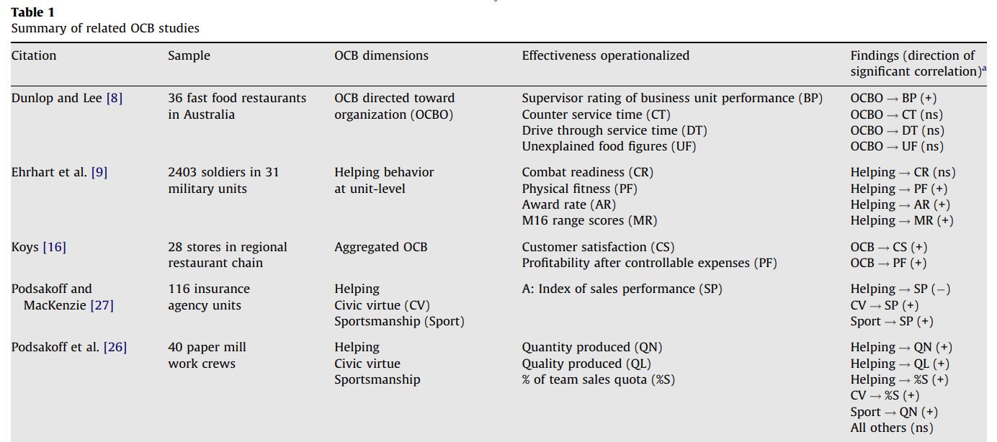
Literature Review

Slide 15
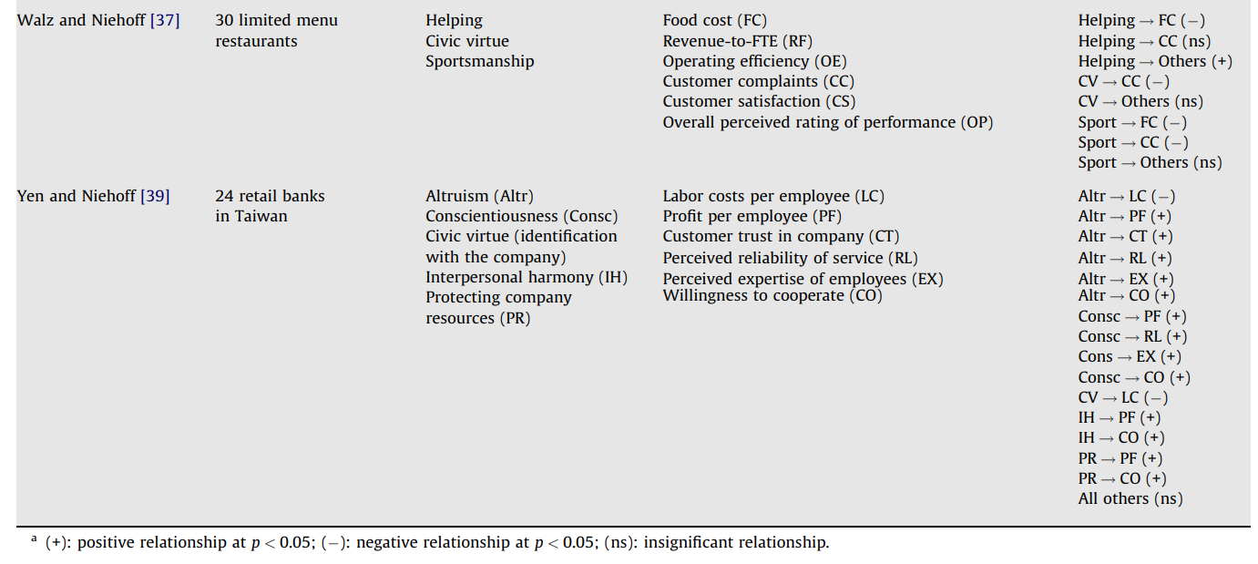
Literature Review

Slide 16
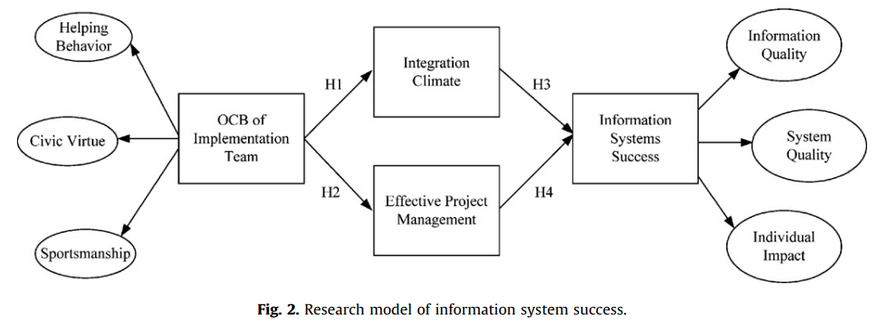
Research Model

Slide 17
Method
Subjects: 330 end users of qualified ERP implementations.
Sample: 262 received, 254 usable.
Process: 156 first wave, 106 second wave.
Profile: 80% front-line personnel; 58.3% service firms; 79% female; 67% aged at 31 to 50; 93.6% high school or undergraduates; 75% interacted with implementation team; 74% used the systems for more than 6 months.

Slide 18
Measures
Construct | Operational Definition | Reference
Organizational citizenship behavior | Voluntary and extra-role behavior demonstrated with helping, civic virtue, and sportsmanship. | Farh et al. (1997) Organ (1988) Podsakoff et al. (1994) Podsakoff et al. (2000)
Integrated Climate | The extent to which employees perceived trust and cooperation with the IS team. | Schneider (1990, 2000) Li, Jiang & Klein (2003) Patterson et al. (2005)
Effective Project Management | Whether IS team : 1) utilizes technology and resources to complete the project; 2) possesses expertise on work process; 3) shows good time management of the project | Aladwani (2002) Kumar et al. (2003)
Information system success | Whether the system is of quality and highly used by its users and whether the system produces positive organizational performance. | DeLone & McLean (1992, 2003) Saarinen (1996) Li (1997)

Slide 19
Data Representativeness
For non-response bias, we compared responses between the first and second waves of questionnaires received (153 versus 101 responses) for all questionnaire items using chi-square or student’s t.
For response bias, all items were compared among demographic groups using chi-square, student’s t, or ANOVA.

Slide 20
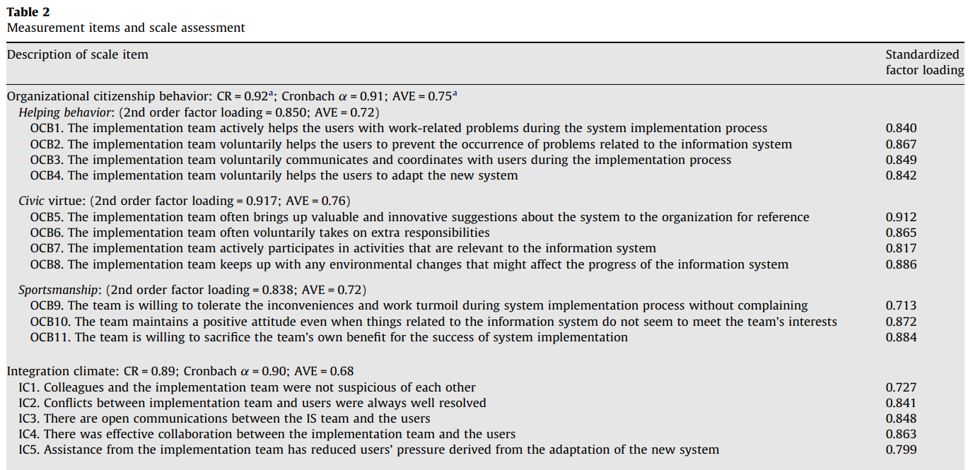
Scale Assessment

Slide 21
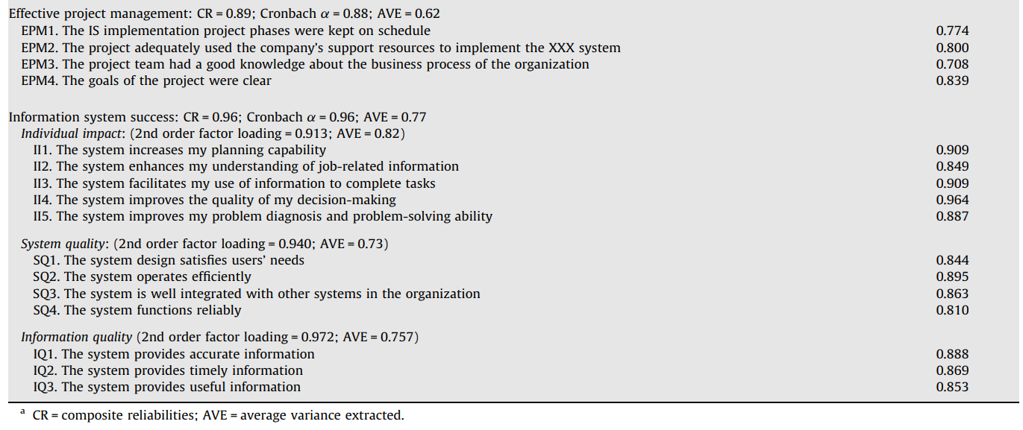
Scale Assessment

Slide 22
Validation

Slide 23
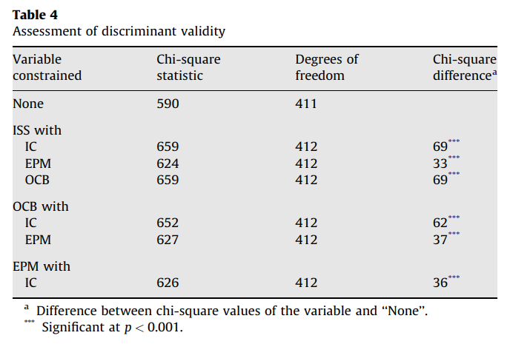
Validation

Slide 24
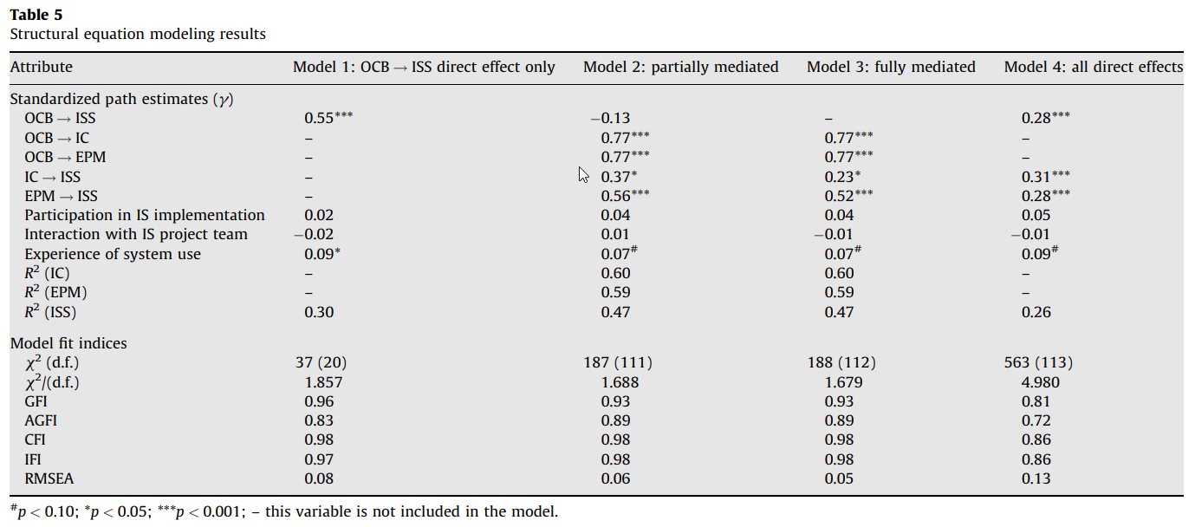
Comparative Models

Slide 25
Model 1: Initial Model
R² =.30
Implementation Team’s OCB
Information System Success
.55***
Helping
Sportsmanship
Civic Virtue
Inform. Quality
System Quality
Individual Impact
Interaction
.09*
Experience
Participation

Slide 26
Model 2: Partially Mediated
R² =.60
Integration Climate
R² =.47
Implementation Team’s OCB
Information System Success
.77***
.37*
Helping
Sportsmanship
Civic Virtue
Inform. Quality
System Quality
Individual Impact
.77***
.56***
R² =.59
Effective Project Management
.07#
Experience

Slide 27
Model 3: Fully Mediated
R² =.60
Integration Climate
R² =.47
Implementation Team’s OCB
Information System Success
.77***
.23*
Helping
Sportsmanship
Civic Virtue
Inform. Quality
System Quality
Individual Impact
.77***
.52***
R² =.59
Effective Project Management
.07#
Experience

Slide 28
Model 4: All Direct Effects
Integration Climate
R² =.26
Implementation Team’s OCB
Information System Success
.31***
Helping
Sportsmanship
Civic Virtue
.28***
Inform. Quality
System Quality
Individual Impact
.28***
Effective Project Management
.09#
Experience

Slide 29
Conclusions
No direct effect of OCB on ISS, but significant indirect effects through integration climate and EPM.
IS and user managers should consider reinforcing organizational practices that nurture OCB.
Managers need to observe the IS implementation process and listen to users directly involved in the implementation.

Slide 30
Conclusions
Implementation team’s OCB can elicit more positive perceptions in the minds of the users about ISS.
When all employees demonstrate high levels of OCB, an organization can truly establish a culture of total quality management.
Creating fair reward systems, making decisions using fair and transparent procedures, and generating trust in the workplace go a long way in developing a culture of OCB among employees.

Slide 31
Thank you very much for listening
Q&A

