Slide 1
SICMM® 1.0 - Service Innovation Capability Maturity Model
Eldon Y. Li
University Chair Professor, Department of MIS
& Director, Innovation Incubation Center
& Founder and Senior Advisor, Center for Service Innovation National Chengchi University ,Taiwan
2010.1.25

Slide 2
Agenda
Background and aim of this project
What is SICMM?
Why is SICMM needed?
Introduction to SICMM
Application of SICMM
Conclusions
Implications for SRII
Q & A

Slide 3
Aim of this project
To propose a service innovation capability maturity model (SICMM) for assisting organizations in effectively implementing service innovation as well as appraising and improving their capability of performing service innovation.

Slide 4
What is SICMM?
SICMM
is a service innovation process model that provides organizations with the essential elements of effective processes in different maturity levels.
can be used to guide service innovation in a team, project, division, or an entire organization.
helps to set service innovation goals and priorities, guide innovative and quality services, and provide a point of reference for appraising current service innovation capability.

Slide 5
Two representations for SICMM
Continuous representation
designed to allow the user to focus on the specific processes that are considered important for the organization's immediate business objectives, or those to which the organization assigns a high degree of risk.
Staged representation
designed to provide a standard sequence of improvements, and can serve as a basis for comparing the maturity of different projects and organizations.
Source: CMU/SEI CMMI-SVC, USA (2009)

Slide 6
Levels for Continuous representation
Level 5
Optimizing
Perform Defect prevention, proactive improvement,
innovation insertion and deployment .
Level 4
Quantitatively
Managed
Quantitatively measure the process performance,
stabilize the process, and
deal with causes of special variations.
Level 3
Defined
Project’s process is tailored from organization’s standard processes, and contributes work products, measures, and other process improvement information to the organization.
Level 2
Managed
The basic infrastructure in place to support the process.
Level 1
Performed
Perform the process needed to provide Services.
Level 0 Incomplete
The process is either is not performed or
partially performed.
Source: CMU/SEI CMMI-SVC, USA (2009)

Slide 7
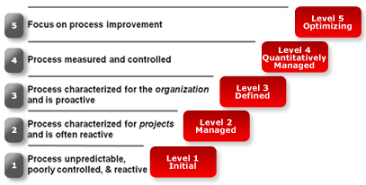
Levels for Staged representation
Source: CMU/SEI CMMI-SVC, USA (2009)

Slide 8
Concept of SICMM
Innovation processes
Mainstream processes
Supportive processes
Administrative processes

Slide 9
Content structure of a process area
Process Area
Purpose Statement
Introductory Notes
Related Process Area
Specific Goals
Generic Goals
Specific Practices
Generic Practices
Typical work
Products
Sub-practices
Sub-practices
Generic Practice Elaboration
Required
Expected
Informative
KEY:
Source: CMU/SEI CMMI-SVC, USA (2009)

Slide 10
Documenting a process area
Process Area (e.g., Financial management)
Purpose
Financial management entails planning for the future of a person or a business enterprise to ensure a positive cash flow. It includes the administration and maintenance of financial assets. Besides, financial management covers the process of identifying and managing risks.
Introductory Notes
Related Process Areas
Refer to the process area for more information about .
Specific Practices by Goal
SG 1
note
SP 1.1
note
example box
Typical Work Products
Subpractices
note
example box
…………

Slide 11
Application of SICMM
SICMM will follow the format of USA CMU/SEI CMMI-SVC to present the best practices of service innovation.
An organization can adopt SICMM appraisal method, similar to that of CMMI-SVC, to appraise its service innovation capability.

Slide 12
Conclusions
～Service innovation is everyone’s business!
～Innovate or die.
～The research and promotion of SICMM is a never-ending game.
～Come and join the team of SICMM.

Slide 13
Implications for SRII
Support SICMM collaborative research
Establish a global community of SICMM centers
Sharing tools and techniques
Sharing experiences and best practices
Share SICMM benchmarking data
Establish a wiki platform for SICMM open innovation.

Slide 14
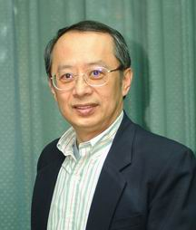
Thank You!
Q&A
Contact
Prof. Dr. Eldon Y. Li
(Emeritus Professor of MIS, Cal Poly, San Luis Obispo, USA) University Chair Professor Director, NCCU Innovation Incubation Center (IIC.NCCU.EDU.TW) Department of Management Information Systems College of Commerce, National Chengchi University
64, Sec. 2, Zhi-nan Rd., Wenshan District, Taipei 11605, TAIWAN
Telephon: +886-2-8661-8082 Fax: +886-2-8661-1384
Email: eli@nccu.edu.tw
http://www.calpoly.edu/~eli

