Slide 1
Trust Dynamics in the Sharing Economy: A Systematic Review
Eldon Y. Li
Chair Professor
Department of MIS
National Chung Cheng University
http://eli.johogo.com
*** All right reserved. Video or audio recording is prohibited. Reference to this document should be made as follows: Li, E.Y. “Trust Dynamics in the Sharing Economy: A Systematic Review,” unpublished lecture, National Chung Cheng University, 2023. ***
Copyright E.Y. Li
2024/6/19
1
Notes:
PARTNER: World
ICT GOODS CAT. Dimension summary (opens new window): Total ICT goods
FLOW: Exports
MEASURE: US dollars at current prices in millions

Slide 2
Trust Dynamics in the Sharing Economy: A Systematic Review
ABSTRACT
Sharing economy users need to place considerable trust in both the persons and the platforms with which they are dealing. Opportunistic consequences for trading partners can be severe, such as property damage or endangerment of personal safety. Trust is a critical factor in overcoming uncertainty and mitigating risk. To understand how users’ trust in the sharing economy is influenced, we performed a systematic literature review. The results show various antecedents of trust in the sharing economy related to multiple entities.
Copyright E.Y. Li
2024/6/19
2

Slide 3
Agenda
About me
E-commerce trend
Social network ties
Definition of trust
Trust reasons
Flow of trust theory
Topology of trust system
Trust repair process
Trust behavior process
Systematic literature review
Summary
Q & A
Copyright E.Y. Li
2024/6/19
3

Slide 4
About Me
Eldon Y. Li is chair professor and former founding director of Department of Information Management at National Chung Cheng University in Chiayi, Taiwan and emeritus professor of MIS at both National Chengchi University in Taiwan and California Polytechnic State University–San Luis Obispo in the US. he received his MSBA and Ph.D. degrees from Texas Tech University, USA. he is listed in the world’s top 2% scientists 2021 version 4 and has published over 300 papers related to electronic business, innovation and technology management, human factors in information technology (it), strategic it planning and e-service operations and quality management. he is the honorary president of International Consortium for Electronic Business and the editor-in-chief of International Journal of Electronic Business and Journal Of Business and Management.

Slide 5
Thanks the COVID-19 pandemic, people are working and buying online longer, contributing to a significant growth in global economy, both traditional and digital, in the U.S.
Source: Adapted from the US Census Bureau News (USCB, 2021). Figure 1. Adjusted total and EC retail sales in the US.
Copyright E.Y. Li
2024/6/19
5

Slide 6
ECONOMY/YEAR | 2000 | 2001 | 2002 | 2003 | 2004 | 2005 | 2006 | 2007 | 2008 | 2009 | 2010
Australia | 1819 | 1701 | 1456 | 1572 | 1712 | 1781 | 1787 | 1942 | 2076 | 1648 | 2040
Brazil | 2230 | 2321 | 2168 | 2097 | 1998 | 3721 | 3962 | 2972 | 3135 | 2315 | 2030
Canada | 20957 | 13094 | 10163 | 10052 | 11846 | 13990 | 14878 | 15065 | 14129 | 10944 | 10687
China | 44135 | 53221 | 78243 | 121365 | 177742 | 234086 | 297653 | 357974 | 396424 | 356301 | 459522
Denmark | 3539 | 3443 | 4691 | 4282 | 4662 | 4067 | 4158 | 4746 | 3921 | 3122 | 3514
France | 31916 | 26310 | 23629 | 23277 | 26864 | 27327 | 31586 | 26140 | 25342 | 19762 | 22584
Germany | 46169 | 46625 | 48665 | 55304 | 72388 | 77168 | 82809 | 78319 | 79012 | 58149 | 66977
India | 714 | 858 | 781 | 957 | 1082 | 1113 | 1344 | 1567 | 1770 | 6099 | 4404
Indonesia | _ | _ | _ | 5687 | 6527 | 6944 | 6138 | 6025 | 6517 | 6921 | 7862
Iran | 4 | 8 | 11 | 20 | 12 | 15 | 53 | .. | .. | .. | 30
Italy | 10705 | 10622 | 9235 | 9843 | 11457 | 11582 | 11369 | 11135 | 10547 | 8219 | 9626
Japan | 108807 | 82103 | 82922 | 91438 | 104339 | 100814 | 103139 | 94022 | 92513 | 70164 | 82187
Mexico | 34771 | 34943 | 33340 | 31845 | 37003 | 38533 | 46916 | 48149 | 56897 | 49764 | 60159
Netherlands | 38150 | 33115 | 28584 | 42633 | 53610 | 58714 | 62306 | 67738 | 63156 | 53342 | 61367
Russia | 411 | 284 | 311 | 324 | 451 | 423 | 771 | 778 | 784 | 838 | 887
South Korea | 59426 | 44871 | 53501 | 65323 | 84555 | 85314 | 86167 | 94694 | 90337 | 79508 | 99813
Spain | 5372 | 5270 | 5000 | 6521 | 7012 | 7197 | 7347 | 6689 | 6819 | 4883 | 5459
Taiwan | 62869 | 49855 | 51146 | 58184 | 62417 | 62145 | 76248 | 77872 | 75487 | 67054 | 94702
Türkiye | 1013 | 1056 | 1603 | 1988 | 2933 | 3227 | 3178 | 2884 | 2407 | 2022 | 2092
United Kingdom | 51529 | 48118 | 47023 | 37475 | 38265 | 52922 | 87070 | 30033 | 28166 | 12310 | 24400
United States | 156742 | 128335 | 111424 | 114860 | 124152 | 128818 | 140314 | 136219 | 138001 | 113157 | 134905
Source: Bilateral trade flows by ICT goods categories, UNCTAD
Figure A: EC values in the top 20 countries and Taiwan (2000-2010)
Copyright E.Y. Li
2024/6/19
6
Notes:
PARTNER: World
ICT GOODS CAT. Dimension summary (opens new window): Total ICT goods
FLOW: Exports
MEASURE: US dollars at current prices in millions

Slide 7
ECONOMY/YEAR | 2011 | 2012 | 2013 | 2014 | 2015 | 2016 | 2017 | 2018 | 2019 | 2020 | 2021
Australia | 2279 | 2245 | 2310 | 2598 | 2636 | 2479 | 2545 | 2535 | 2935 | 2546 | 2961
Brazil | 1789 | 1328 | 1166 | 881 | 856 | 721 | 777 | 844 | 780 | 666 | 730
Canada | 11186 | 10310 | 9556 | 9156 | 8762 | 8236 | 8190 | 8246 | 8132 | 6670 | 7407
China | 508012 | 554310 | 605756 | 607567 | 603903 | 555824 | 612663 | 680528 | 661751 | 701639 | 857505
Denmark | 3831 | 3483 | 3570 | 3971 | 3467 | 3480 | 3922 | 4034 | 4017 | 4219 | 4931
France | 24763 | 22719 | 22481 | 21864 | 19877 | 19465 | 20586 | 22523 | 21059 | 18429 | 21271
Germany | 68845 | 63553 | 62871 | 67721 | 61797 | 62964 | 71682 | 77543 | 73181 | 71606 | 82118
India | 6580 | 5734 | 5358 | 3092 | 2351 | 2480 | 2544 | 3813 | 6478 | 5661 | 8793
Indonesia | 7845 | 7713 | 6600 | 6116 | 5294 | 4868 | 5040 | 5194 | 5042 | 5437 | 6752
Iran | 15 | .. | 26 | 40 | 42 | 9 | 15 | 16 | .. | .. | ..
Italy | 11013 | 9352 | 9042 | 8844 | 8669 | 8606 | 9611 | 10946 | 10574 | 10989 | 12070
Japan | 75966 | 73048 | 61813 | 57763 | 53236 | 53615 | 58297 | 59849 | 56439 | 57009 | 65202
Mexico | 59368 | 62497 | 61804 | 62518 | 60973 | 59843 | 65241 | 67823 | 68296 | 66619 | 71000
Netherlands | 64405 | 58177 | 59036 | 61840 | 49482 | 50285 | 55386 | 59871 | 59229 | 61275 | 69250
Russia | 1227 | 1643 | 2203 | 3967 | 2770 | 1796 | 2371 | 2126 | 2261 | 1713 | ..
South Korea | 99857 | 94036 | 107127 | 113410 | 114410 | 110331 | 141925 | 168395 | 139727 | 148113 | ..
Spain | 4820 | 3703 | 3343 | 3636 | 3458 | 3883 | 4723 | 5020 | 5489 | 5382 | 6242
Taiwan | 105765 | 101029 | 105646 | 116814 | 110238 | 120602 | 139206 | 142827 | 152878 | 182938 | 230403
Türkiye | 2232 | 2643 | 2775 | 3125 | 2717 | 2202 | 2190 | 2194 | 2073 | 1704 | 1986
United Kingdom | 24144 | 20386 | 20949 | 21272 | 19122 | 18525 | 18772 | 18994 | 18716 | 16580 | 17313
United States | 140896 | 139532 | 140037 | 145225 | 141752 | 139975 | 146473 | 148159 | 143744 | 138375 | 158926
Source: Bilateral trade flows by ICT goods categories, UNCTAD
Figure B: EC values in the top 20 countries and Taiwan (2011-2021)
Copyright E.Y. Li
2024/6/19
7
Notes:
PARTNER: World
ICT GOODS CAT. Dimension summary (opens new window): Total ICT goods
FLOW: Exports
MEASURE: US dollars at current prices in millions

Slide 8
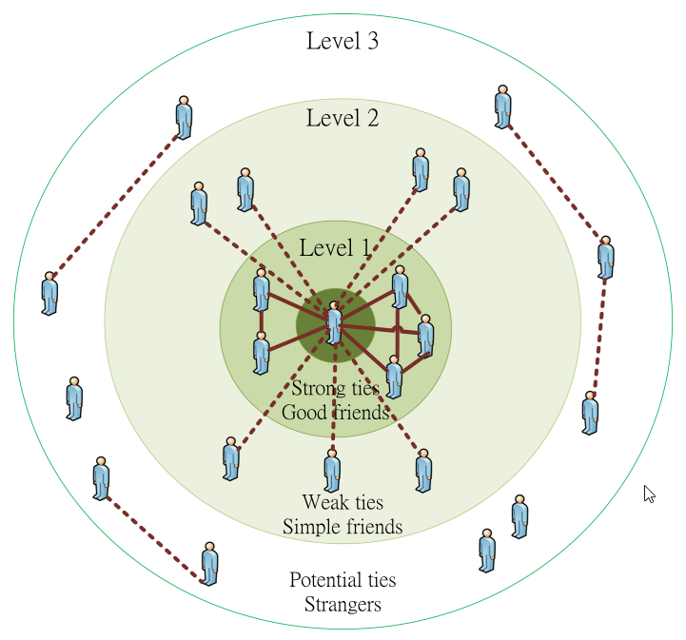
Source: Li, Liang, and Li (2018) Figure 2A: Levels of ties in a social network

Slide 9
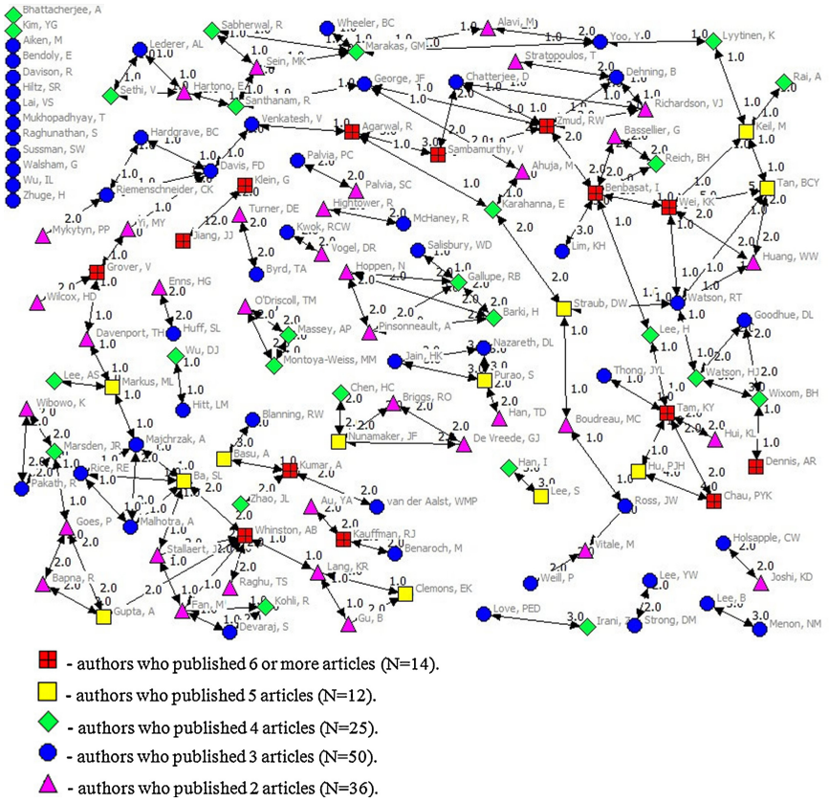
Source: Li, Liao, and Li (2013) Figure 2B: Levels of ties in a co-authorship network
Copyright E.Y. Li
2024/6/19
9

Slide 10
Definition
Trust implies a three-part relationship involving at least two actors and one act (Guinnane, 2005): A (trustor) trusts B (trustee) to do C (act/task), even though the degree of trust varies and is restricted to certain contexts (Hardin, 2002).
Trust must be based on enduring relationships and encapsulated interests. The trust cannot prevail without both. With an encapsulated interest, a trustor trusts a trustee because he or she thinks the trustee has the best interest to continue their relationship (enduring relationship) and therefore is interested in taking the trustor’s interest into account.
Copyright E.Y. Li
2024/6/19
10

Slide 11
Definition
Trust is “the willingness of a party (trustor) to be vulnerable to the actions of another party (trustee) based on the expectation that the other (trustee) will perform a particular action important to the trustor, irrespective of the ability to monitor or control that other party (trustee)” (Mayer, Davis, & Schoorman, 1995, p. 715).
Copyright E.Y. Li
2024/6/19
11

Slide 12
Trust reasons before/after experience
Calculative reason refers to the consideration of the costs or the benefits associated with a trustee acting in an untrustworthy way.
Interactive reason is people assess another party’s behavior and performance during their interactions, thus forming trust based on their interactive experiences.
Cognitive reason refers to the deliberation on the information about a trustee, allowing one to interpret and predict a trustee’s behavior.
Source: Wang and Benbasat (2008)
Copyright E.Y. Li
2024/6/19
12

Slide 13
Trust reasons before/after experience
Dispositional reason is based on an individual’s general predisposition to trust other parties.
Institutional reason is associated with societal structures (e.g., legislation, rules, guarantees, and third-party assurances) that people believe will make an environment trustworthy.
Heuristic reason is that trust may arise from heuristic cues, such as first impressions, and be transferred from other sources. according to the theory of swift trust, heuristic cues can generate trust quickly even prior to having firsthand experiences
Source: Wang and Benbasat (2008)
Copyright E.Y. Li
2024/6/19
13

Slide 14
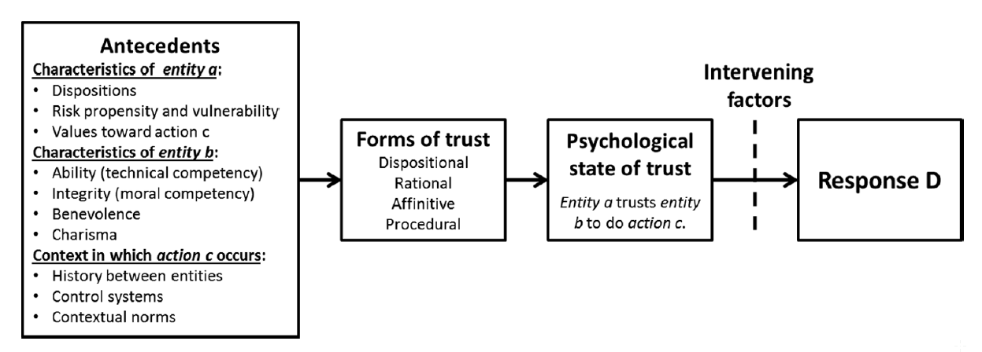
Source: Stern and Coleman (2015) Figure 3: Key components and flow of trust theory
Copyright E.Y. Li
2024/6/19
14

Slide 15
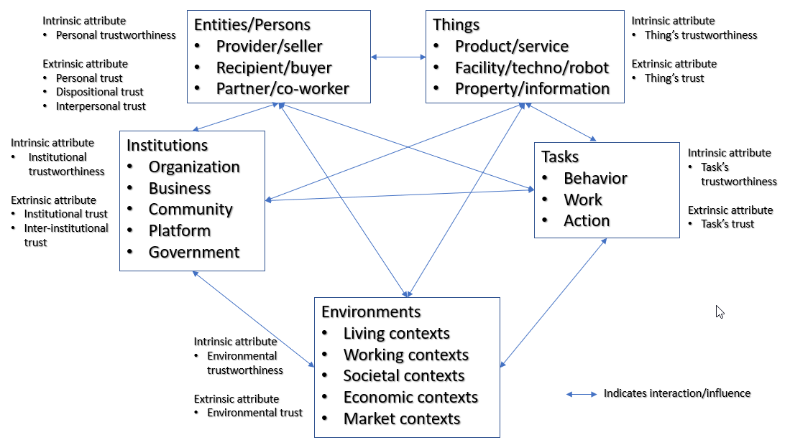
Trust attributes:
Trustworthiness → Intrinsic
Trust → Extrinsic
Source: This study. Figure 4: Proposed topology of trust and trustworthiness in the trust system
Copyright E.Y. Li
2024/6/19
15

Slide 16
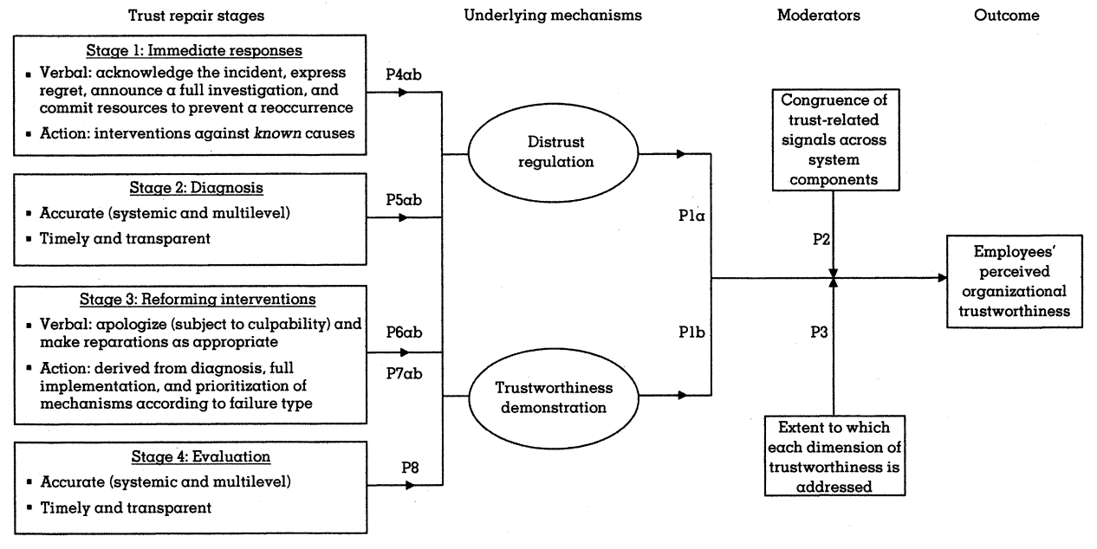
Source: Gillespie and Dietz (2009)
Figure 5: The four stages of the organization-level trust repair process
Copyright E.Y. Li
2024/6/19
16

Slide 17
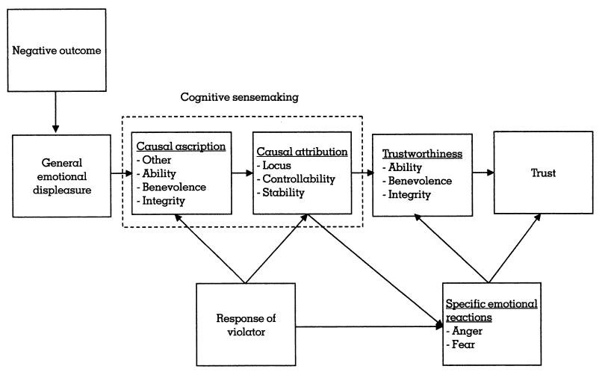
Source: Tomlinson and Mayer (2009)
Figure 6: The causal attribution model of trust repair
Copyright E.Y. Li
2024/6/19
17

Slide 18
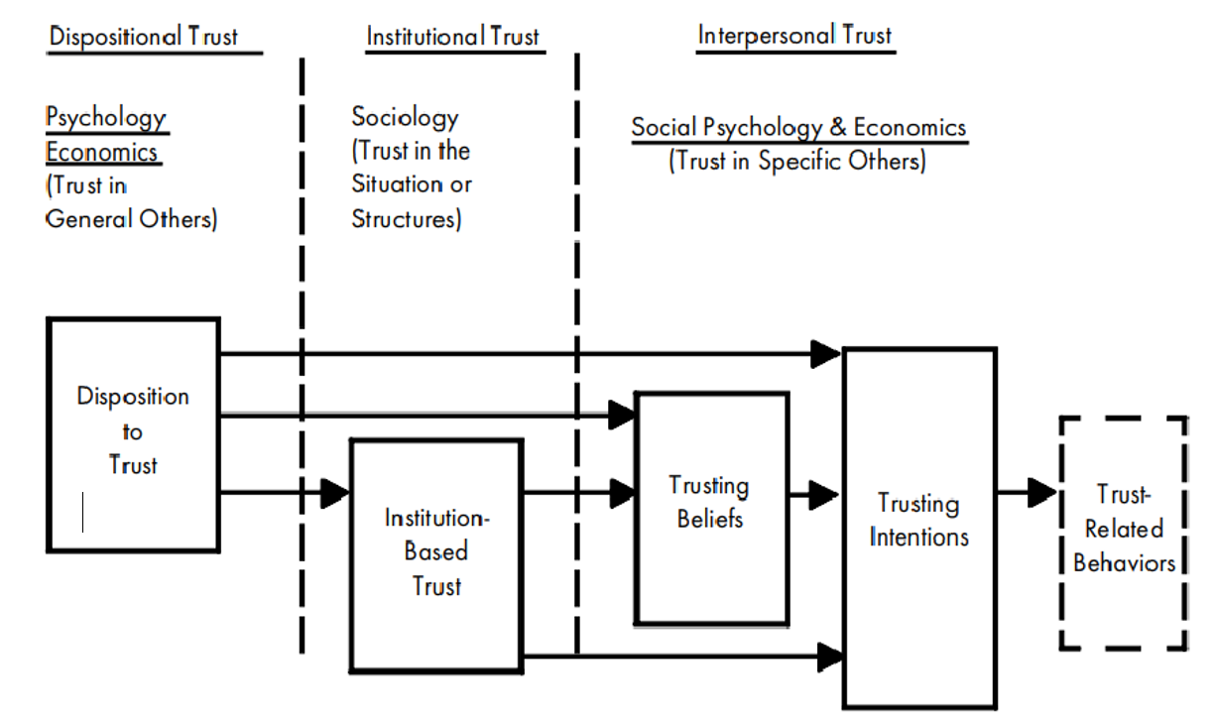
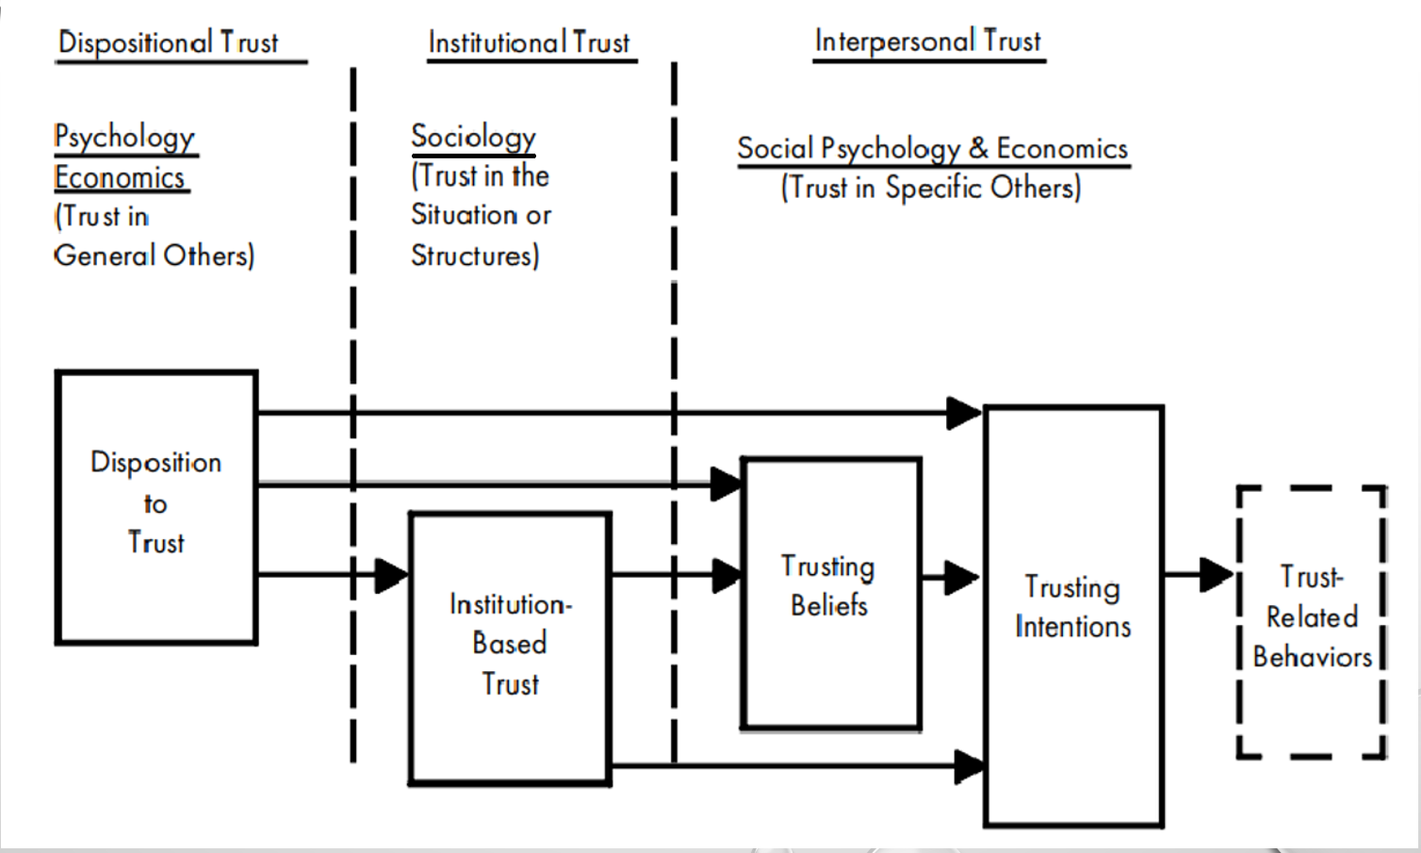
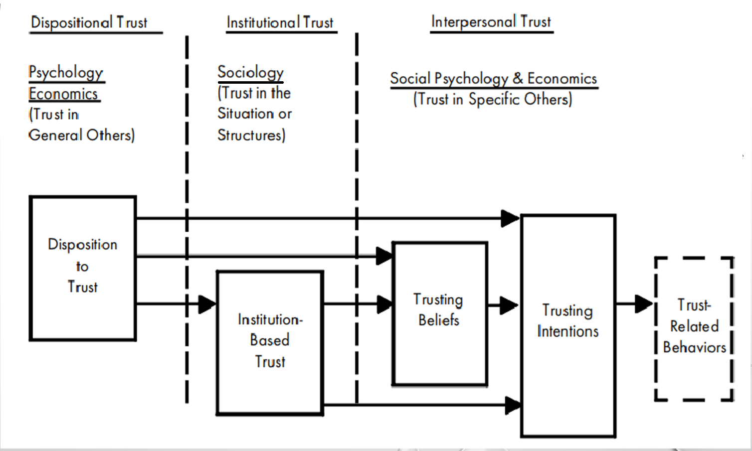
Source: McKnight and Chervany (2001) Figure 8: Trust-related behavior process in e-commerce
Copyright E.Y. Li
2024/6/19
18

Slide 19
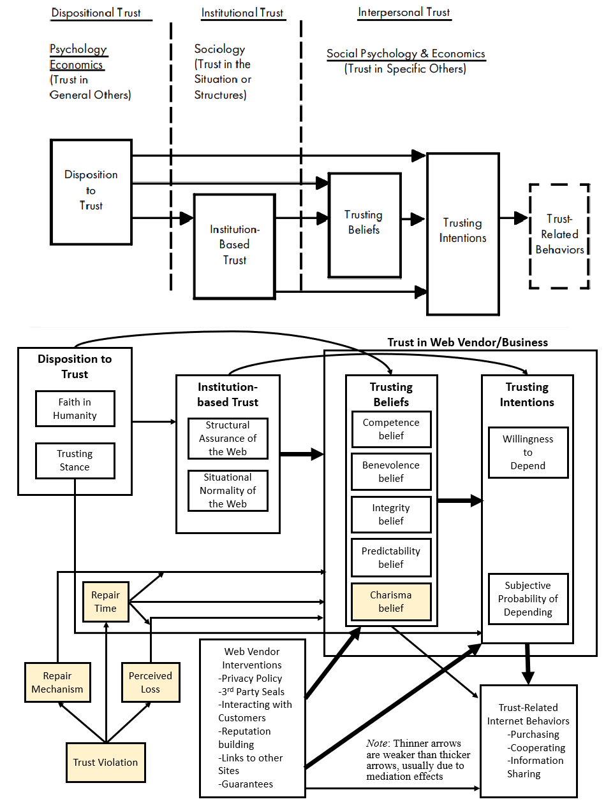
Source: McKnight and Chervany (2001) Figure 8: Trust-related behavior process in e-commerce
Copyright E.Y. Li
2024/6/19
19

Slide 20
Source: McKnight and Chervany (2001) Figure 8: Trust-related behavior process in e-commerce
Copyright E.Y. Li
2024/6/19
20

Slide 21
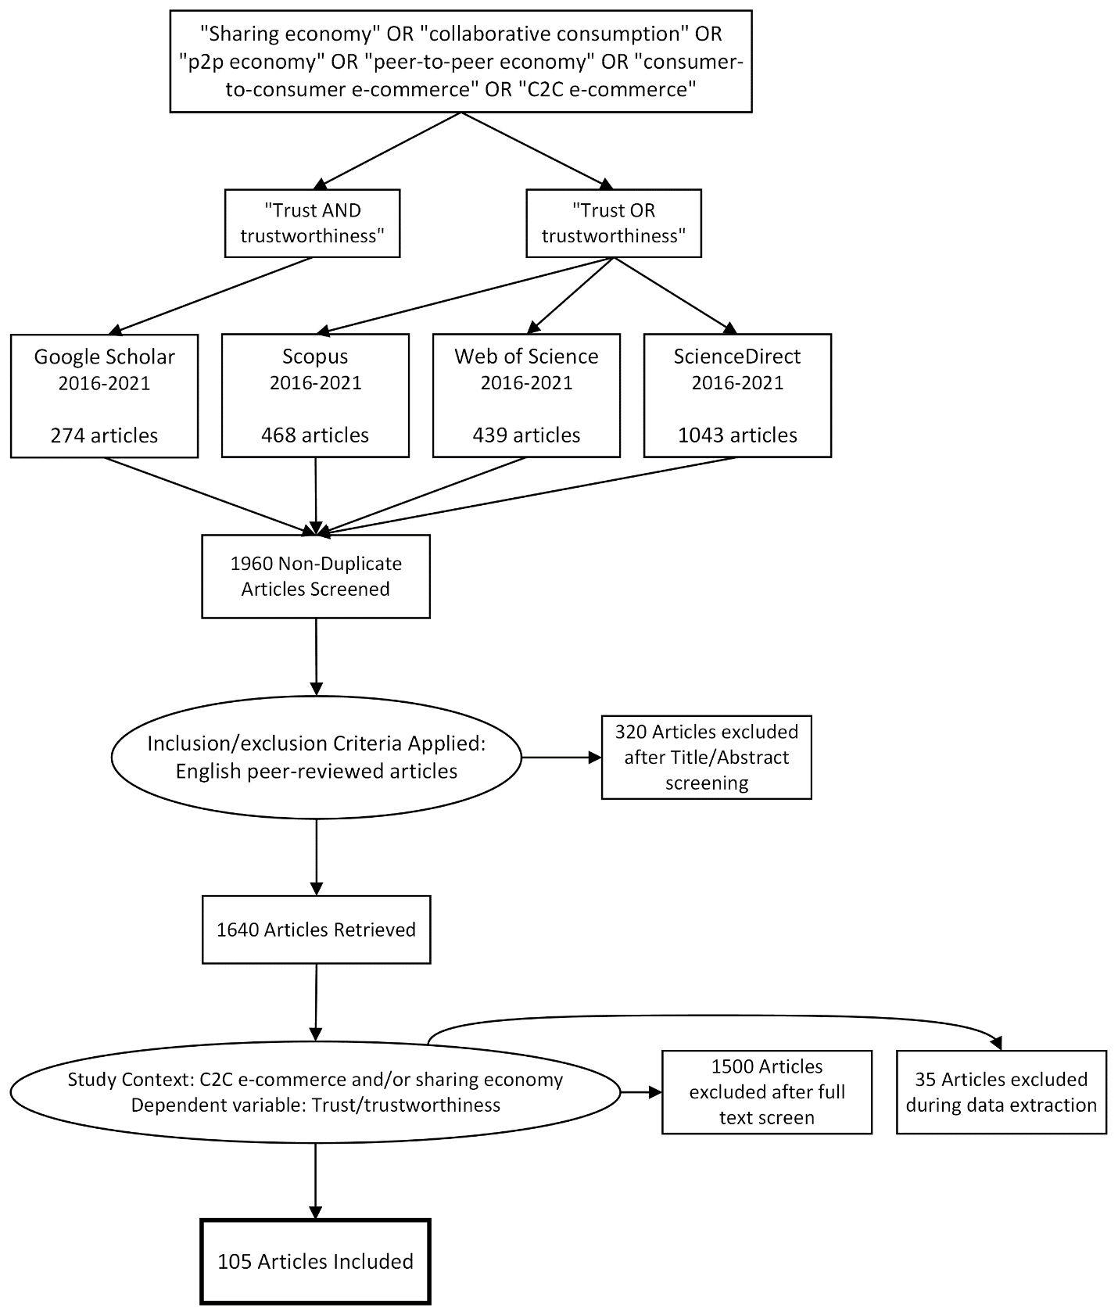
Figure X. Selection process in the systematic review

Slide 22
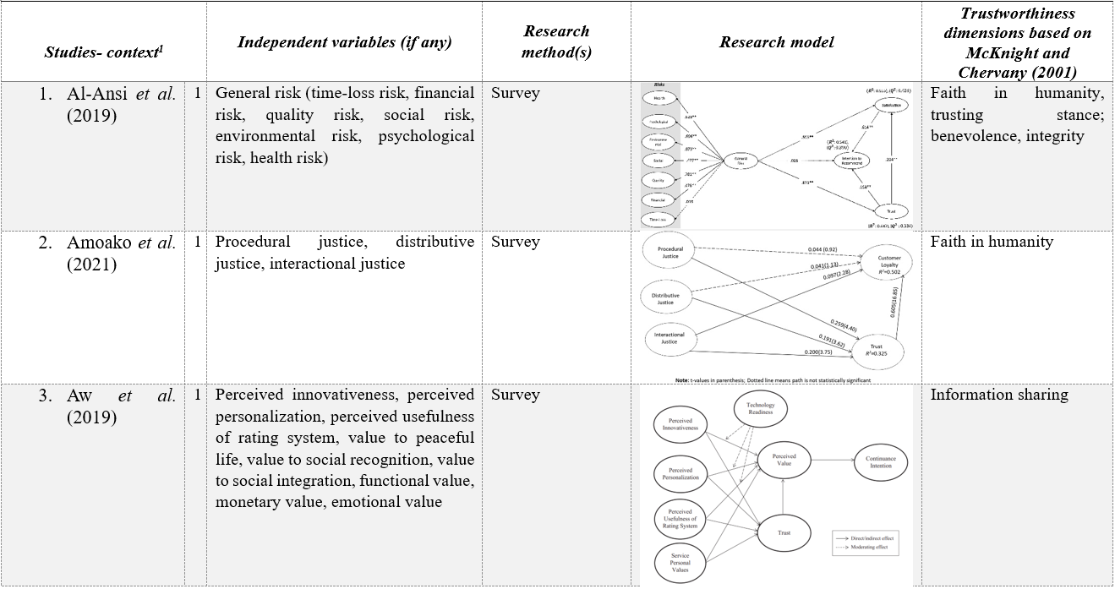
Table X. Full details of the included articles (three examples)

Slide 23
Research method | N
Survey | 84
Experiment | 21
Interview | 5
Literature review | 3
Conceptual | 3
Exploratory research | 1
Figure Y. Frequency analysis of research methods used

Slide 24
Table Y. Frequency of trustworthiness dimensions and subdimensions
Dimension | Subdimension | N
Disposition to Trust | Faith in humanity | 15
 | Trusting stance | 24
Institution-based Trust | Situational normality | 17
 | Structural assurance | 30
Trusting Beliefs | Competence belief | 31
 | Benevolence belief | 32
 | Integrity belief | 39
 | Predictability belief | 10
Trusting Intentions | Willingness to depend | 25
 | Subjective probability of depending | 9
Trust-Related Internet Behaviors | Cooperation | 9
 | Information sharing | 34
 | Purchasing | 10
Source: McKnight and Chervany (2001)

Slide 25
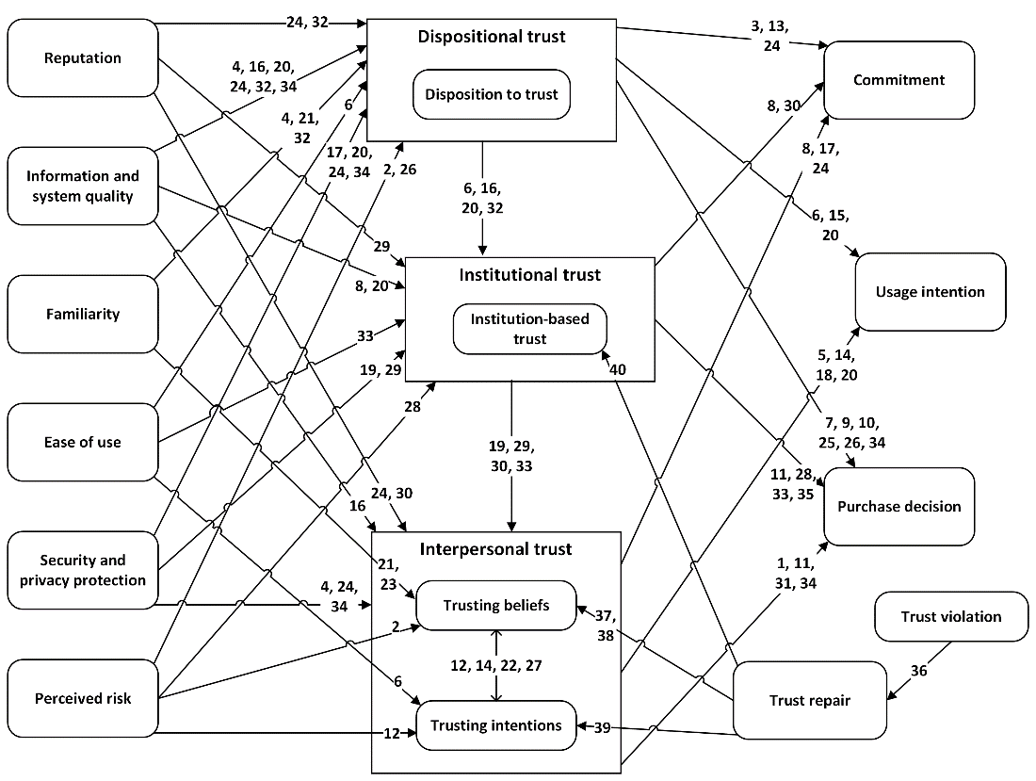
Antecedents
Figure Z. Associations of trust dimensions in the trust model (Version 1)

Slide 26
Table Z2. Antecedents in two sampled groups
Paper ID | Antecedents | Group
96 | Accommodation characteristics | Environment and Mechanism
70 | City familiarity | Environment and Mechanism
50 | Institutional mechanisms | Environment and Mechanism
26 | Organizational legitimacy | Environment and Mechanism
57 | Pragmatic legitimacy, normative legitimacy, cognitive legitimacy, regulative legitimacy | Environment and Mechanism
53 | Soft regulation, harsh regulation | Environment and Mechanism
78 | Stability, controllability, intentionality, repentance, interactional justice, procedural justice, distributive justice | Environment and Mechanism
29 | Trust in the incumbent platform | Environment and Mechanism
89 | Uncertainty avoidance | Environment and Mechanism
77 | Uncertainty avoidance | Environment and Mechanism
48 | Information quality | Information
36 | Information quality (readability, information amount) | Information
102 | Information support | Information
100 | Informational repair | Information
68 | Informational support | Information
45 | Informational support | Information
98 | Message ratio | Information
18 | Precision of the information, consistency of the information | Information
76 | Profile photo, profile information | Information
Source: This study

Slide 27
Table Z1. Frequency of trust antecedent groups
Antecedent Group | N
Environment and Mechanism | 10
Information | 9
Organizations and Third-Party | 8
Personal (mental, financial, rewards) | 56
Quality, Platform, and System | 23
Relationships and Interactions | 20
Responses | 6
Risk Factors | 13
Society, Culture, and Economy | 18
Technology and Innovation | 8
Time | 3
Source: This study

Slide 28
Summary
Trust is the bedrock of EC and social capital.
Trust is dynamic, not static.
Trust is contextual.
Trust needs an index, like ESG.
Trust needs a unified theory.
Trust model is complex and evolutional.
Copyright E.Y. Li
2024/6/19
28

Slide 29
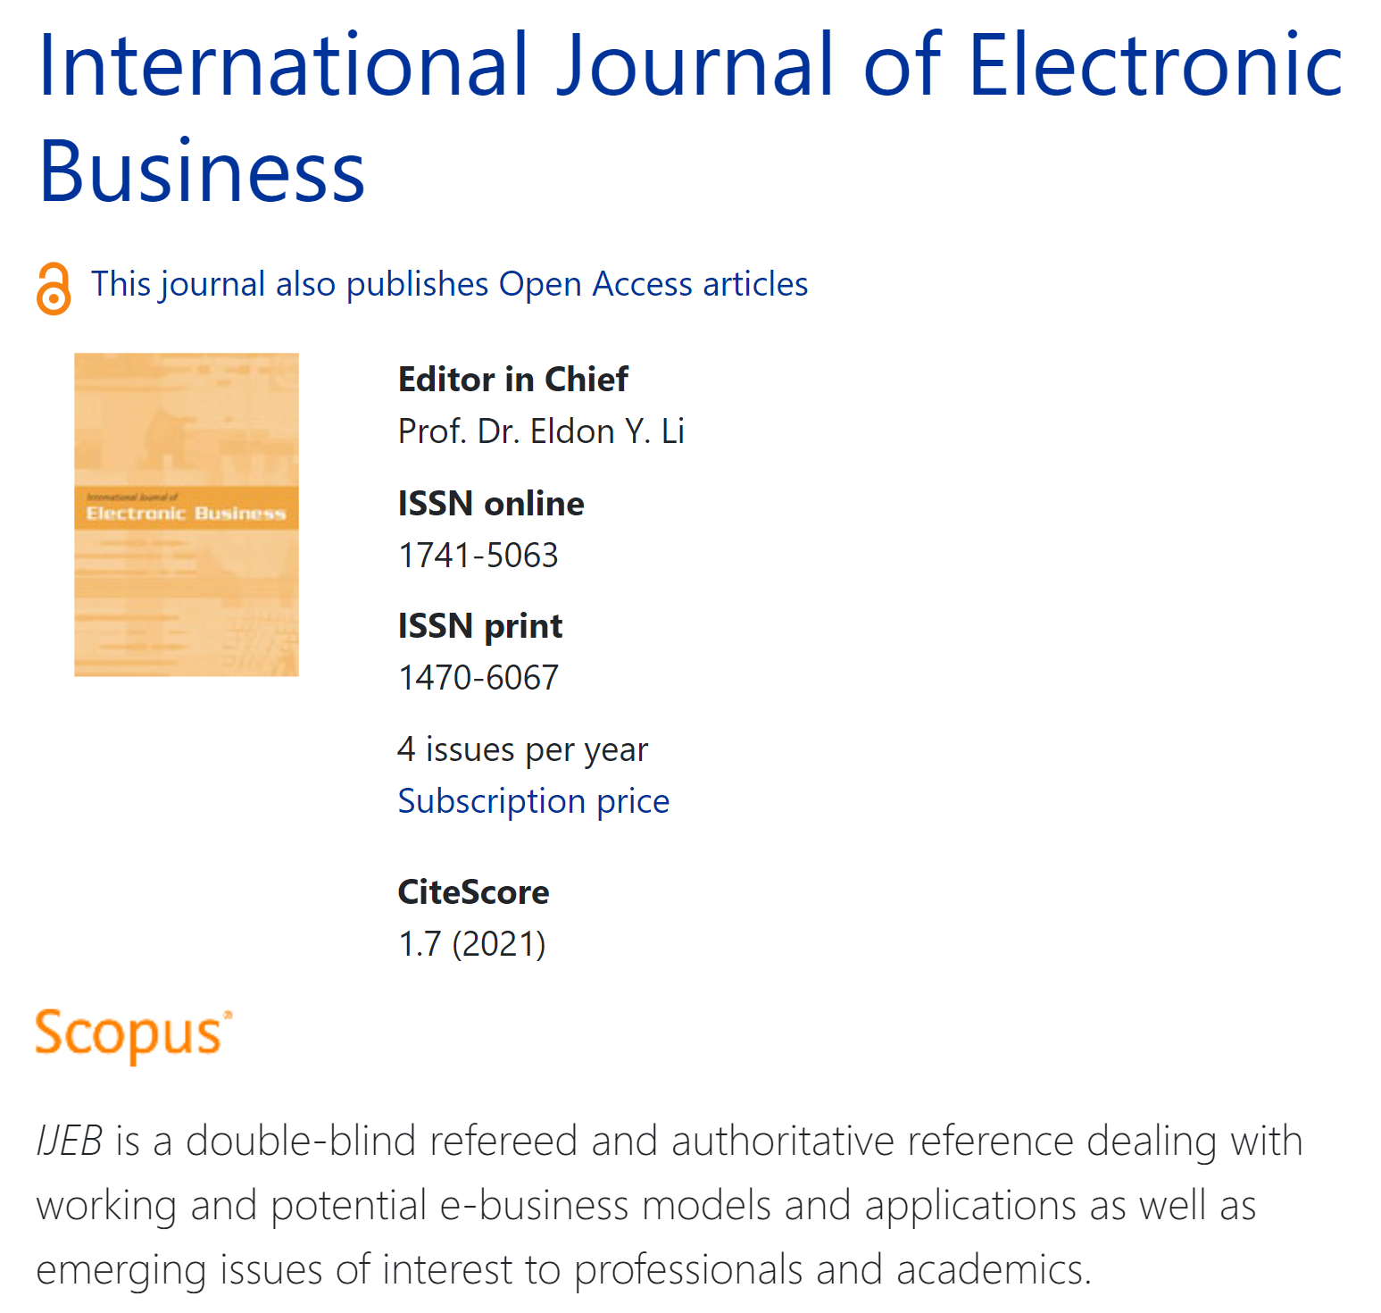
https://www.inderscience.com/ijeb
Copyright E.Y. Li
2024/6/19
29

Slide 30
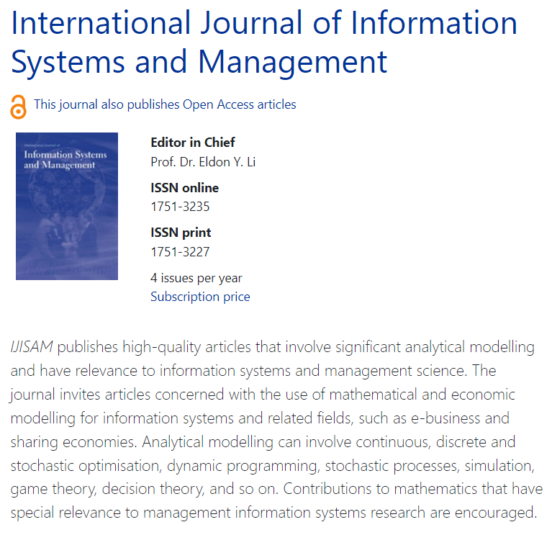
https://www.inderscience.com/ijisam
Copyright E.Y. Li
2024/6/19
30

Slide 31
Thanks much for listening
Q & A

